Slide 1
Critical Design Review NG iDesign G0D RAPID-X
Team Members: Youssef Samwel, Nicolas Sayeed, Pablo Rodriguez, Davi Dantas, Evan Kasky, Timothy Ogg
Advisors: Dr. Mike Borowczak and Dr. Chung Yong Chan

Slide 2






Youssef Samwel Electrical Engineering
Nicolas Sayed Electrical Engineering
Timothy Ogg Computer Engineering
Pablo Rodriguez Computer Engineering
Davi Dantas Electrical Engineering
Evan Kasky Computer Engineering

Slide 3
Motivation and Background
Growing demand for custom processors
Modern computing relies heavily on optimized application-specific processors hence the need for custom ASIC design
Recall the 2020 global chip shortage as an exposed weakness to the semiconductor industry from automotive to defense highlighting the need for domestic chip design expertise.
Critical for national security, economic resilience, and technological independence.
Hands-on ASIC development is essential for future engineers due to the growing need for specialized talent in custom chip design.

Slide 4
Goals
Successfully tape out an ASIC implementing the RISC-V instruction set in ~45nm .
Use existing EDA tools and relevant design technology libraries
Gain in-depth knowledge of the ASIC design flow and Cadence tooling
Develop troubleshooting skills throughout the design process
Create clear and comprehensive project documentation

Slide 5
Objectives
Design an ASIC which implements the RISC-V RV32I base Instruction set, excluding memory ordering and environmental/system calls
Perform functional and/or formal verification of the design to confirm functionality. Target add minimum 85% code coverage.
Synthesize the design into a netlist for physical layout. Target the 45nm FreePDK45 technology using the Nangate open cell library.
Use electronic design tools to perform physical design and create a layout of the design.
Conduct static timing analysis, IR drop, and electromigration analysis to ensure physical performance requirements are met. Use physical design techniques such as design rule checking to establish design manufacturability as well as layout vs schematic to determine correctness of the physical design.

Slide 6
Stretch Goals
Insert design for test structures to validate functionality of the manufactured IC.
Perform gate-level simulation to verify the design with real clock delays.
Use logic equivalence checking to validate the functional equivalence between different stages of the development process.

Slide 7
Engineering Requirements
No. | Requirement | Specification | Description | Priority
1 | Processing Speed | ≥ 100 MIPS | The design should process at least 100 MIPS. | H
2 | RV32I Compatibility | ≥ 38 Instr. | Handle at least 37 unique instructions, excluding memory ordering and environment calls. | H
3 | Low Power Consumption | ≤ 1W | Efficient design meeting specs under 1W power. | H
4 | Cache Size | ≥ 16 MB | Incorporate an L1 cache of at least 16 MB. | H
5 | Process Node | ≤ 45nm | Implemented with a process size of at most 45nm. | H
6 | Operating Voltage Range | 0.95 V - 1.25 V | Operate correctly within this voltage range | H
7 | Operating Temperature Range | 0 °C - 125 °C | Operate correctly within this temperature range. | M
8 | IR Drop | ≤ 5% | Voltage drops below 5% of expected voltage. | M
9 | Timing Failure Count | 0 Faults | No timing faults over any operating period. | H
All engineering requirements in this table have been accomplished and highlighted.

Slide 8
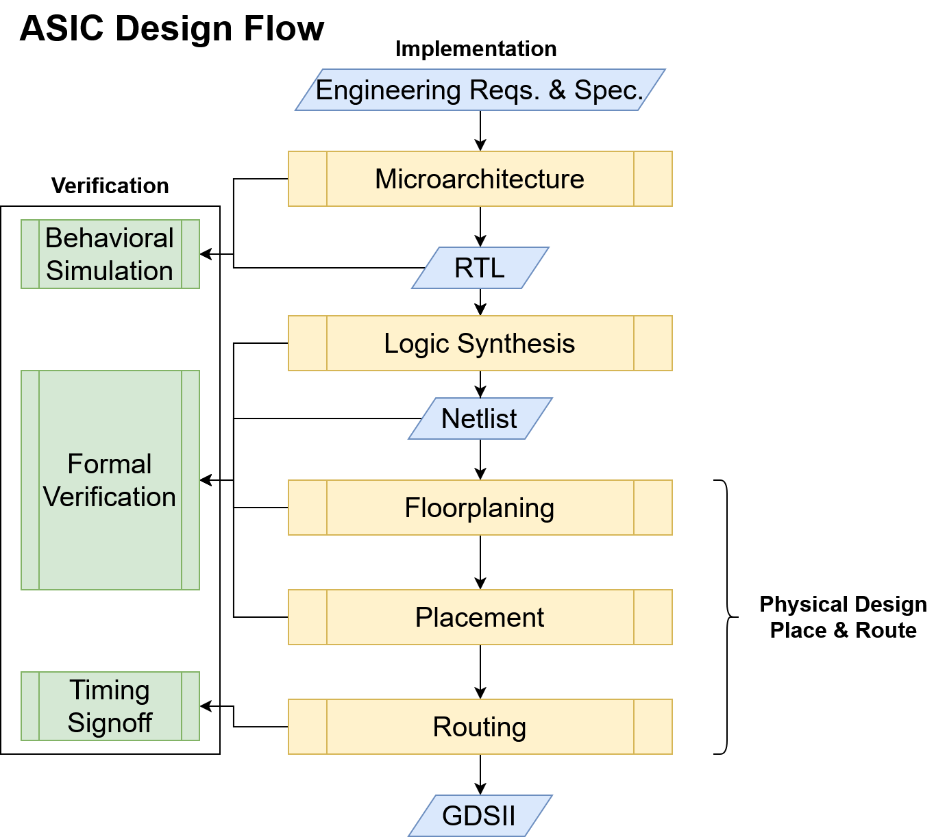
IC Design Flow and Tool Selection
Available Toolchains: Cadence Suite, Synopsys Suite, Xilinx Tools
Design & Synthesis: Cadence Xcelium, Cadence Genus, Xilinx Vivado
Verification: Synopsys VCS, Cadence Xcelium, Cadence Jasper, Xilinx Vivado, Cadence Conformal
Synthesis: Cadence Genus, Cadence Modus
Physical Layout: Cadence Virtuoso, Cadence Innovus, Cadence Pegasus

Slide 9
Toolchain Comparison
 | Cadence Suite | Synopsys | Xilinx Tools
Benefits | -Tool suite for specialized IC development. -Used heavily in industry specifically for IC development -Includes trainings for each tool | -Very effective for verification using UVM and provided better feedback to the tester than any other alternative. -Includes a whole suite for specialized IC development. | -Vivado can be downloaded and is faster for design, simulation, and verification when compared to server-based tool alternatives.
Tradeoffs | -Server based access; high software latency. -Restricted access meaning limited documentation online. | -Server based access; high software latency. -Restricted access meaning limited documentation online. | -Xilinx does not provide any other tool for specialized IC development.
Team Usage | -Used heavily for Verification, Synthesis, physical layout, and physical layout testing. | -Used specifically for verification development. | -Used heavily for design and verification.

Slide 10
Hardware Comparison Architecture Overview
Aspect | Single-Cycle | Multi-Cycle | Pipelined
Clock Cycle Time | Longest Instruction | Flexible | Shorter cycles
Efficiency | Low | Moderate | High
Control Complexity | Simple | Moderate | High
Hardware Utilization | Inefficient | Efficient | Very Efficient
Hazard Management | No hazard | No hazard | Complex hazards
Power Efficiency | Low | Moderate | High
Typical Usage | Simple designs | Moderate designs | Complex designs

Slide 11
Hardware Comparison Team Implementation
Options | Tradeoffs
Option A - Team designed 5 Stage Pipeline model without hardware implemented hazard and forwarding unit. | RTL Designed by Team (minus hazard/forwarding) Software based hazard detection via custom compiler Learn more about pipeline stages Phase 2 goals would prove more difficult to meet engineering requirements Medium complexity
Option B - Team designed Single Cycle implementation | Simplest to design and implement Fast RTL development Low throughput; may not reach 100MIPS goals Plenty of reference material Perceived increased chance of completing entire ASIC flow Low complexity
Option C - 5 stage Pipeline with hardware implemented Hardware Detection Unit and Forwarding Unit. | High throughput potential Good documentation available Complex for current experience level Steeper learning curve Perceived decreased chance of completing entire ASIC flow High complexity
Option D - Reverse engineering Ripes.me models and code. It would require turning their open-source C++ code into RTL code. | Use Ripes open source C++ as a base Translate to RTL from scratch System logic already defined Feasible if translation is efficient Medium-to-high complexity
Initial
We initially selected option A but ended up implementing a hazard detection unit and a forwarding unit for the core; otherwise known as option C.
Final

Slide 12
Hardware Comparison Memory Implementation
Category | Von Neumann | Harvard | Modified Harvard
Memory Structure | Single memory space which shares data and instructions | Separate memory space for data and instructions | Separate Data and Instruction Cache with a unified main memory space
Bus Structure | Single Bus | Dual bus | Dual Bus & Shared Bus
Simplicity | Simpler hardware | Simpler programming | Middle ground
Cost | Simpler leads to a lower cost | Additional hardware leads to higher cost | Middle ground
Performance | Possible memory bottleneck leads to less performance | Higher memory bandwidth leads to better pipeline | Almost achieves the same performance as standard Harvard
The team implemented a Harvard architecture based memory subsystem as it was presumed to be the simplest to design while also allowing us to hit our engineering requirements performance wise.

Slide 13
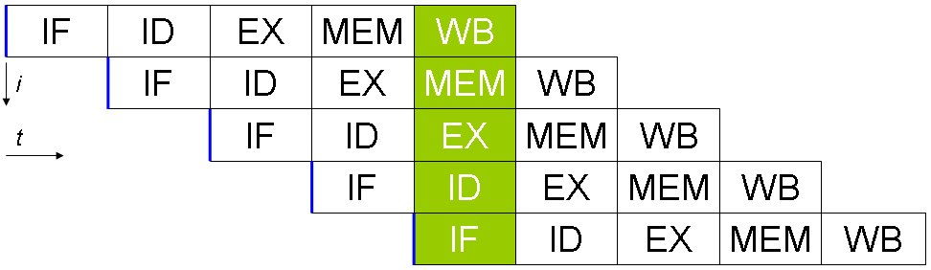
Summary of Design Requirements
Target Instructions / Clock: 1 (IPC)
Support the 37 RISC instructions
100 MIPS - Million Instructions per Second
Notes:
Here is the summary of design requirments for the RTL team,
We had to support 37 RISC instructions while achieving an Instruction per Clock or IPC rate of 1. The sponsor had set a goal of 100 Million Instructions per Second or MIPS. Given that our IPC rate target is 1, our clock frequency would have to be 100 MHz to achieve the MIPS goal.

Slide 14

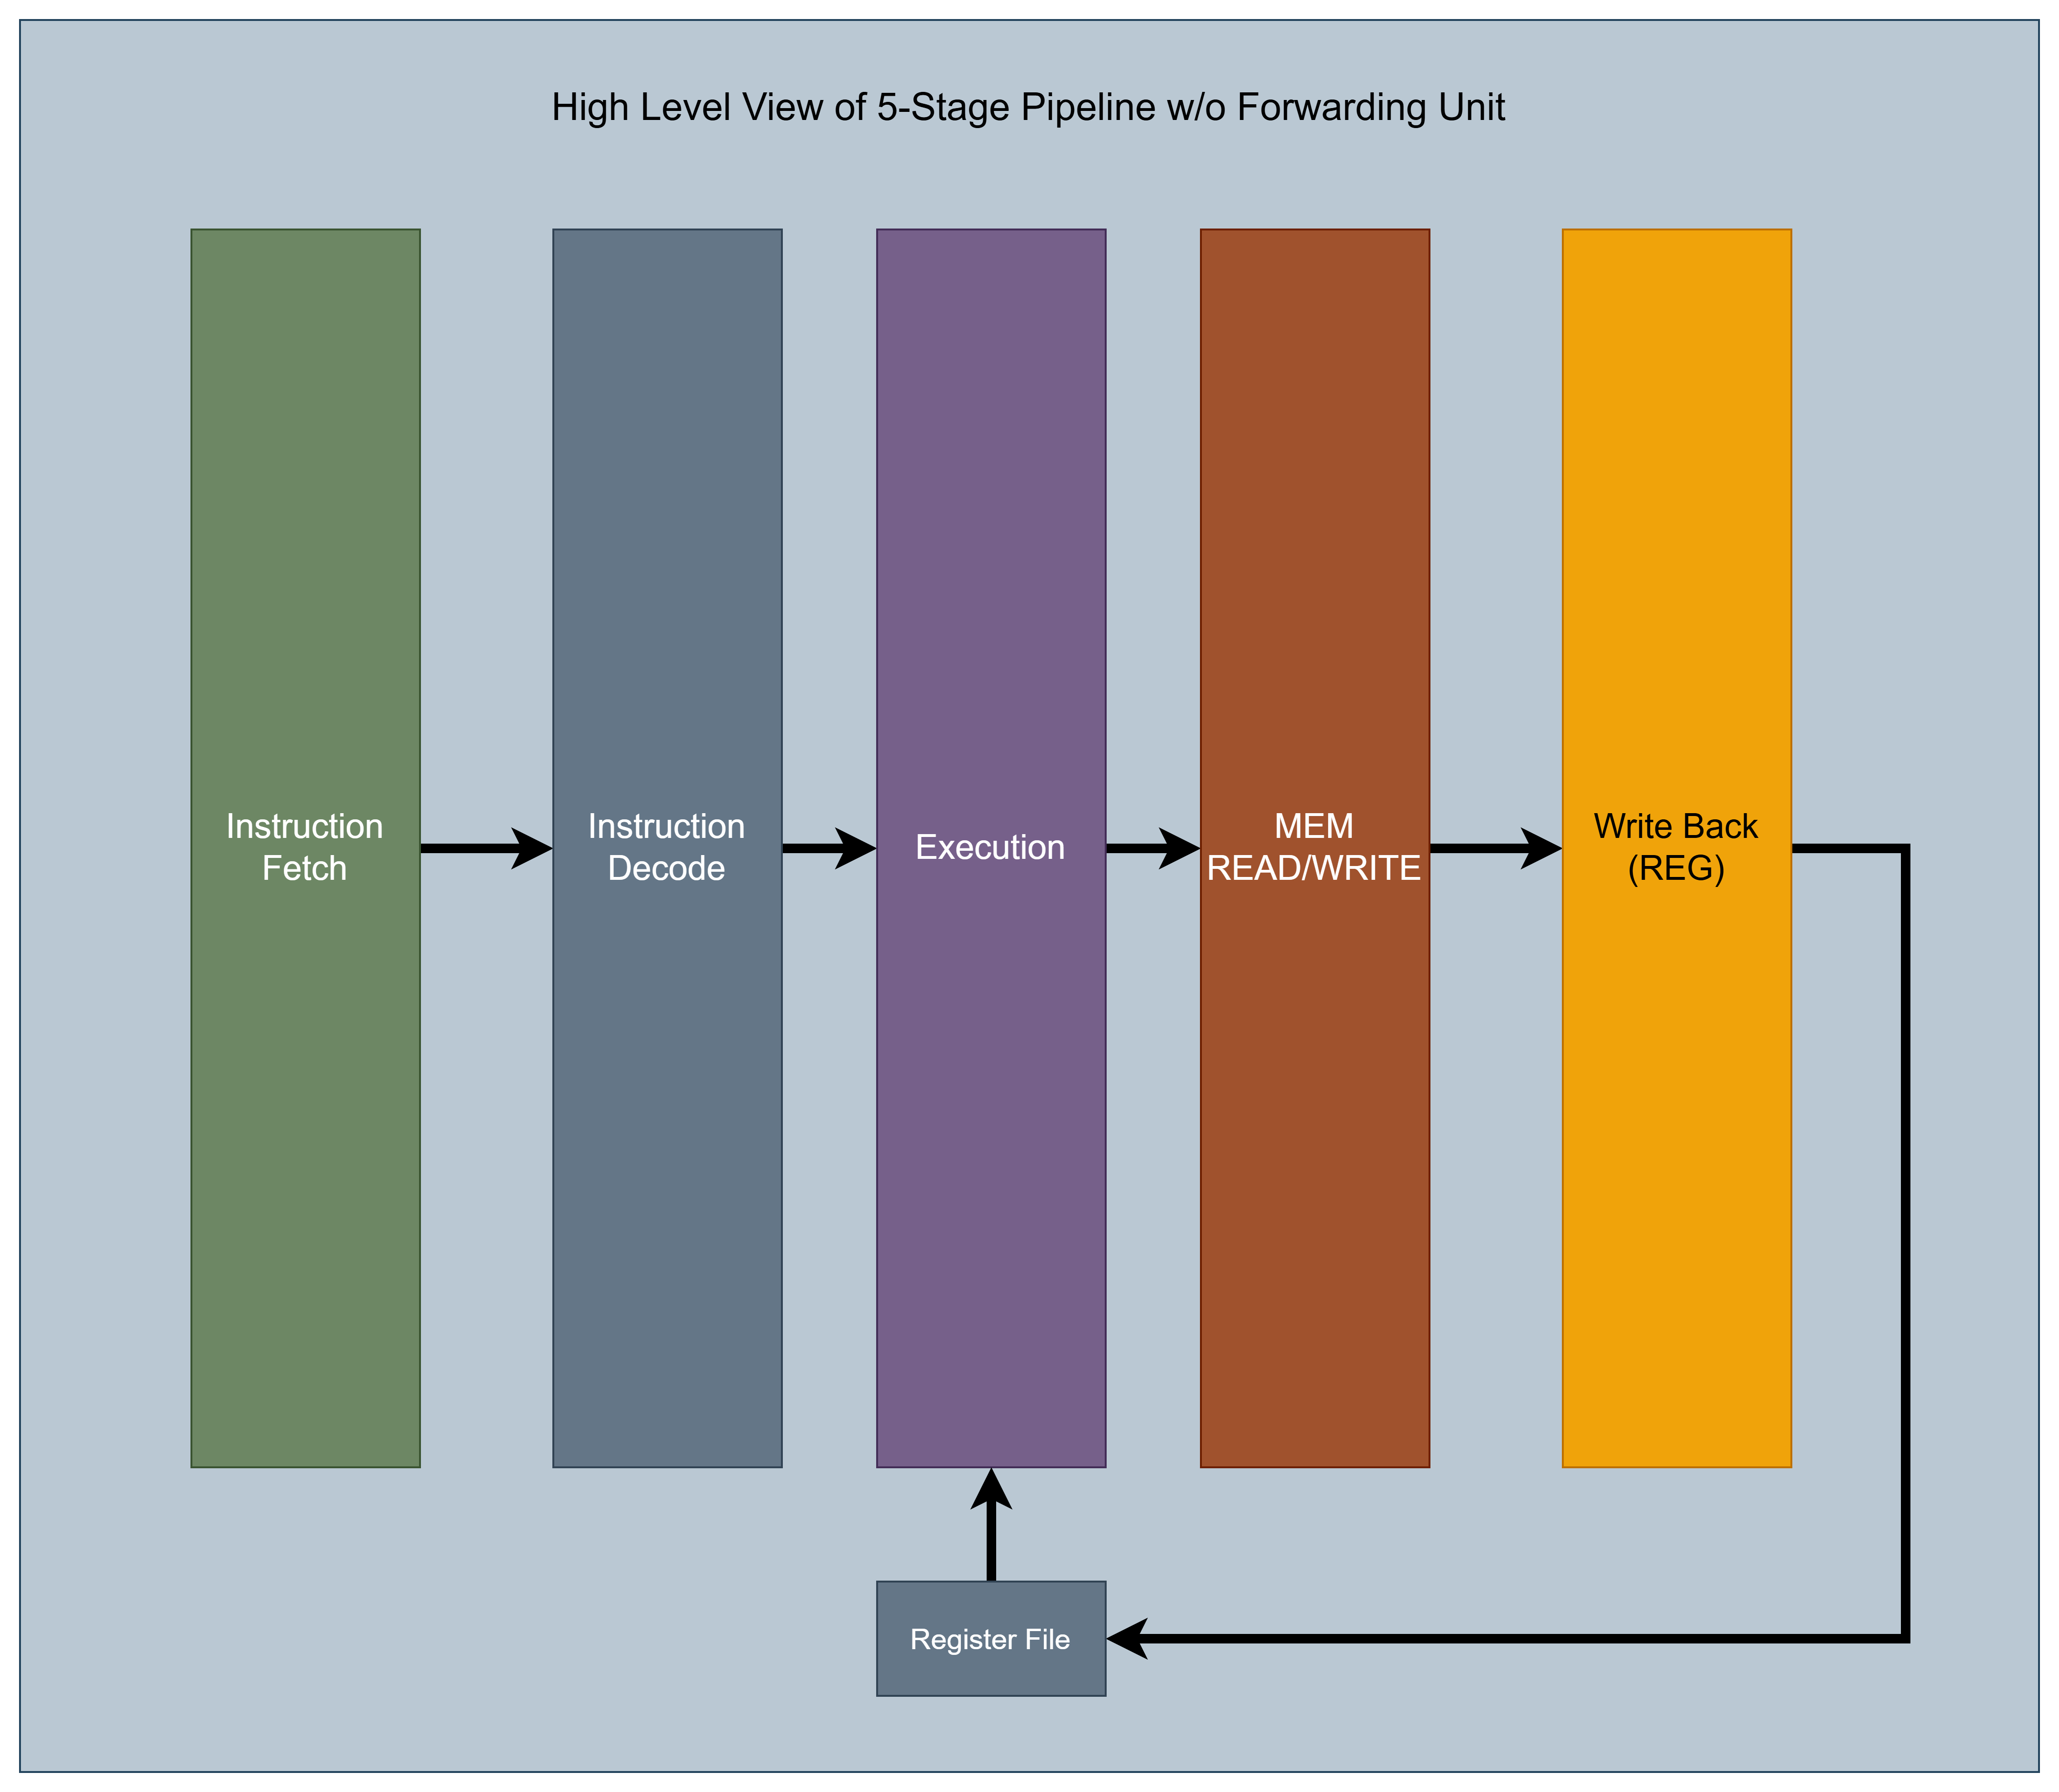
RAPID Core
First iteration and proof of concept.
Split core operations into sperate blocks. Better division of labor.
Reusable hardware allows better efficiency.
Microarchitectural Limitation:
No hardware support hazards.
No environment calls/interrupts.
Notes:
The RAPID core represented our first design iteration and served as a proof of concept. It featured a 5-stage pipeline architecture, enabling hardware block reusability to improve overall efficiency.
To simplify the design and focus on core functionality, we chose not to implement hardware-based hazard handling. A data hazard occurs when an instruction depends on the result of a previous instruction that has not yet been written back to the register file. For example, if an addition is followed by an instruction that uses its result, a hazard would occur without proper handling.
Additionally, we did not include support for interrupts or system calls, as these features were not required by our project sponsor.
Regarding the division of labor, Nicolas and I were responsible for defining the top-level RTL specifications for each block and developing the Instruction Decode, Execute, and Write Back stages. While, Timothy and Pablo handled the Instruction Fetch and Memory stages, including cache design and integration.

Slide 15
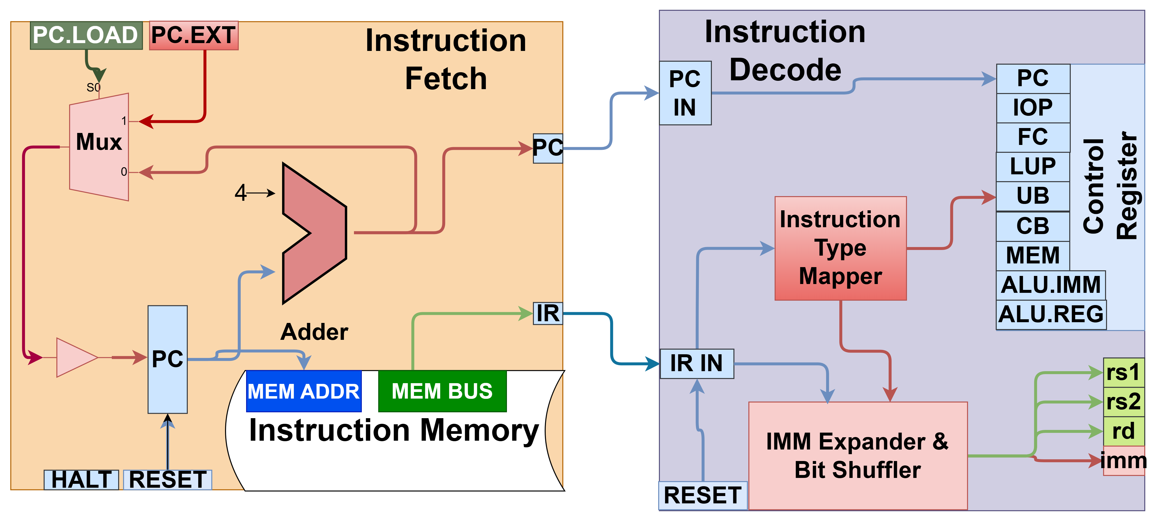
RAPID Core – Instruction Fetch & Decoder
Instruction Fetch: 1. PC (Program Counter) register 2. Branching 3. Interfacing with instruction cache. 4. Push nop's to avoid pipeline stalls.
Decoder: 1. Populate control register (27 bits, later reduced to 25-bits). 2. Parse the immediate value.
Notes:
The instruction fetch stage would manage the program counter which points to the next instruction to execute. The instruction fetch stage also had support for branching and would flush the pipeline with nops or "no operation" instructions when a branch occurred.
The decoder would detect the instruction type and parse parameters from the bitfield like destination and source registers. The final output would be 27-bit control register which would be used later in the pipeline to enable the proper hardware blocks.

Slide 16
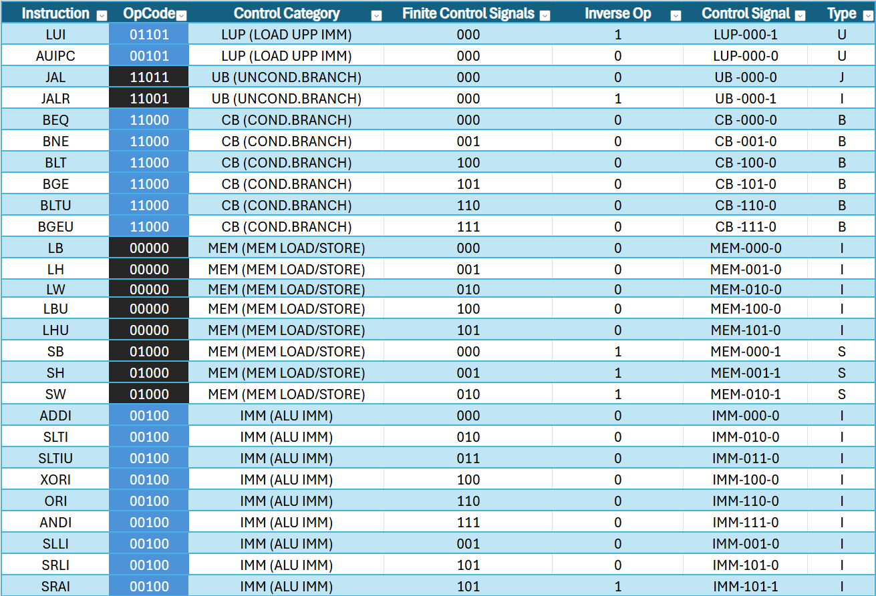
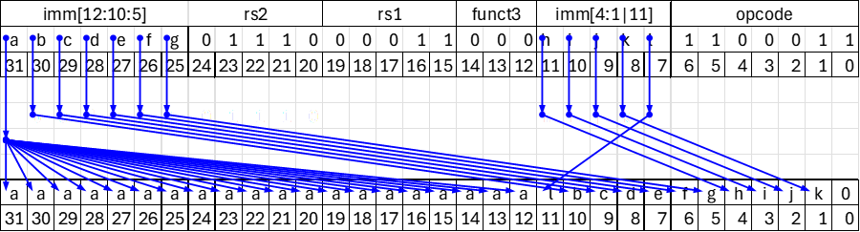
RAPID Core – Instruction Fetch & Decoder Cont.
Opcode is mapped to a specific family.
Finite Control Signal (FCS) is used to select specific operations in a digital logic block.
Inverse Operation (IOP) is used to share common hardware such as an adder which can be also used for subtraction.
Bit mapper shuffles and sign extends based on instruction type.
Notes:
This slide explains in more detail what the decoder stage does. It begins by mapping the opcode portion to an family group. A family group is a collection of hardware blocks that have similar functionality such as memory operations, branching, and so forth. Afterwards, it selects the proper the finite control signal or FCS which are used inside the family group to specify the dedicated hardware block. For example, the family group would specify that the current instruction is memory operation and the FCS code would specify that it is load byte operation. The final control bit, the 'Inverse Operation' or IOP is used to allow multiuse for the same hardware blocks. For example, the hardware adder can also be used for subtraction.
The final task of the decoder stage is to detangle the immediate value. The picture on the bottom left shows how to map the immediate value bits for B-type instruction.

Slide 17
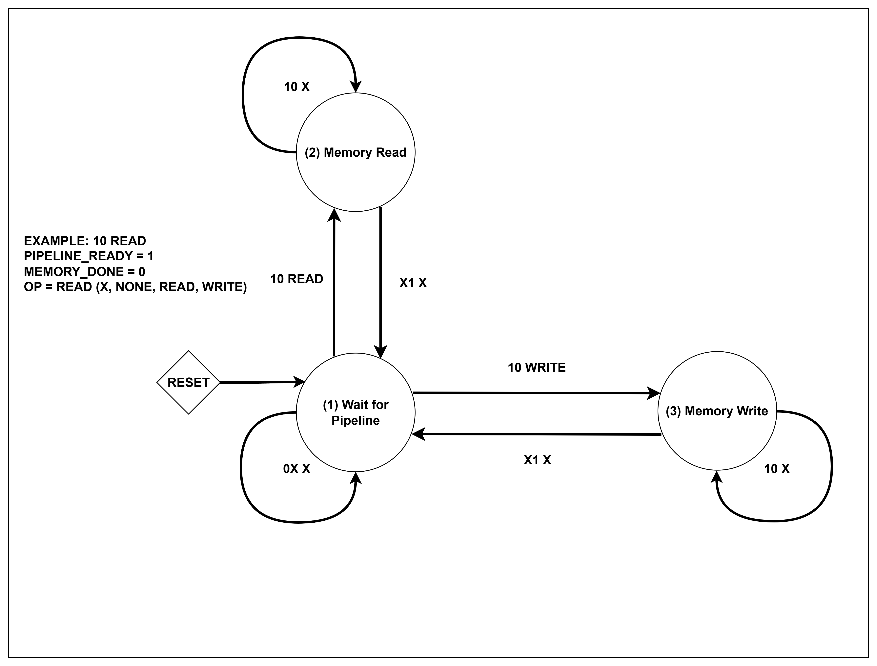
RAPID Core – Memory Stage Finite State Machine (FSM)
FSM Example:
Original FSM for memory stage.
Would stall pipeline until memory read/write was completed.
Would stall pipeline even without data hazards.
Could be reduced to only two states. Optimized in Rapid-x.
Notes:
This slide shows an example of a finite state machine for the first revision of the memory stage.
It would stall the pipeline until memory reads or writes were completed.
The FSM for this stage could be reduced to only two states which improves the IPC rate of the overall core.

Slide 18
Motivation for RAPID-X
Race conditions in microarchitecture.
High CPI and high latency.
Could not meet power requirement with realized CPI.
Notes:
The motivations for the second revision of RAPID where the following,
We had a race condition in the micronarchiecture
Without a forwarding unit and hazard control, the pipeline had higher latency and worse IPC
For us to reach the 100 MIPs goal, we would need a much higher clock frequency. Running the core at higher frequency is undesirable because of power constraints but more importantly, the technology node we are using is relatively slow therefore it would more difficuilt to meet timing constraints.

Slide 19
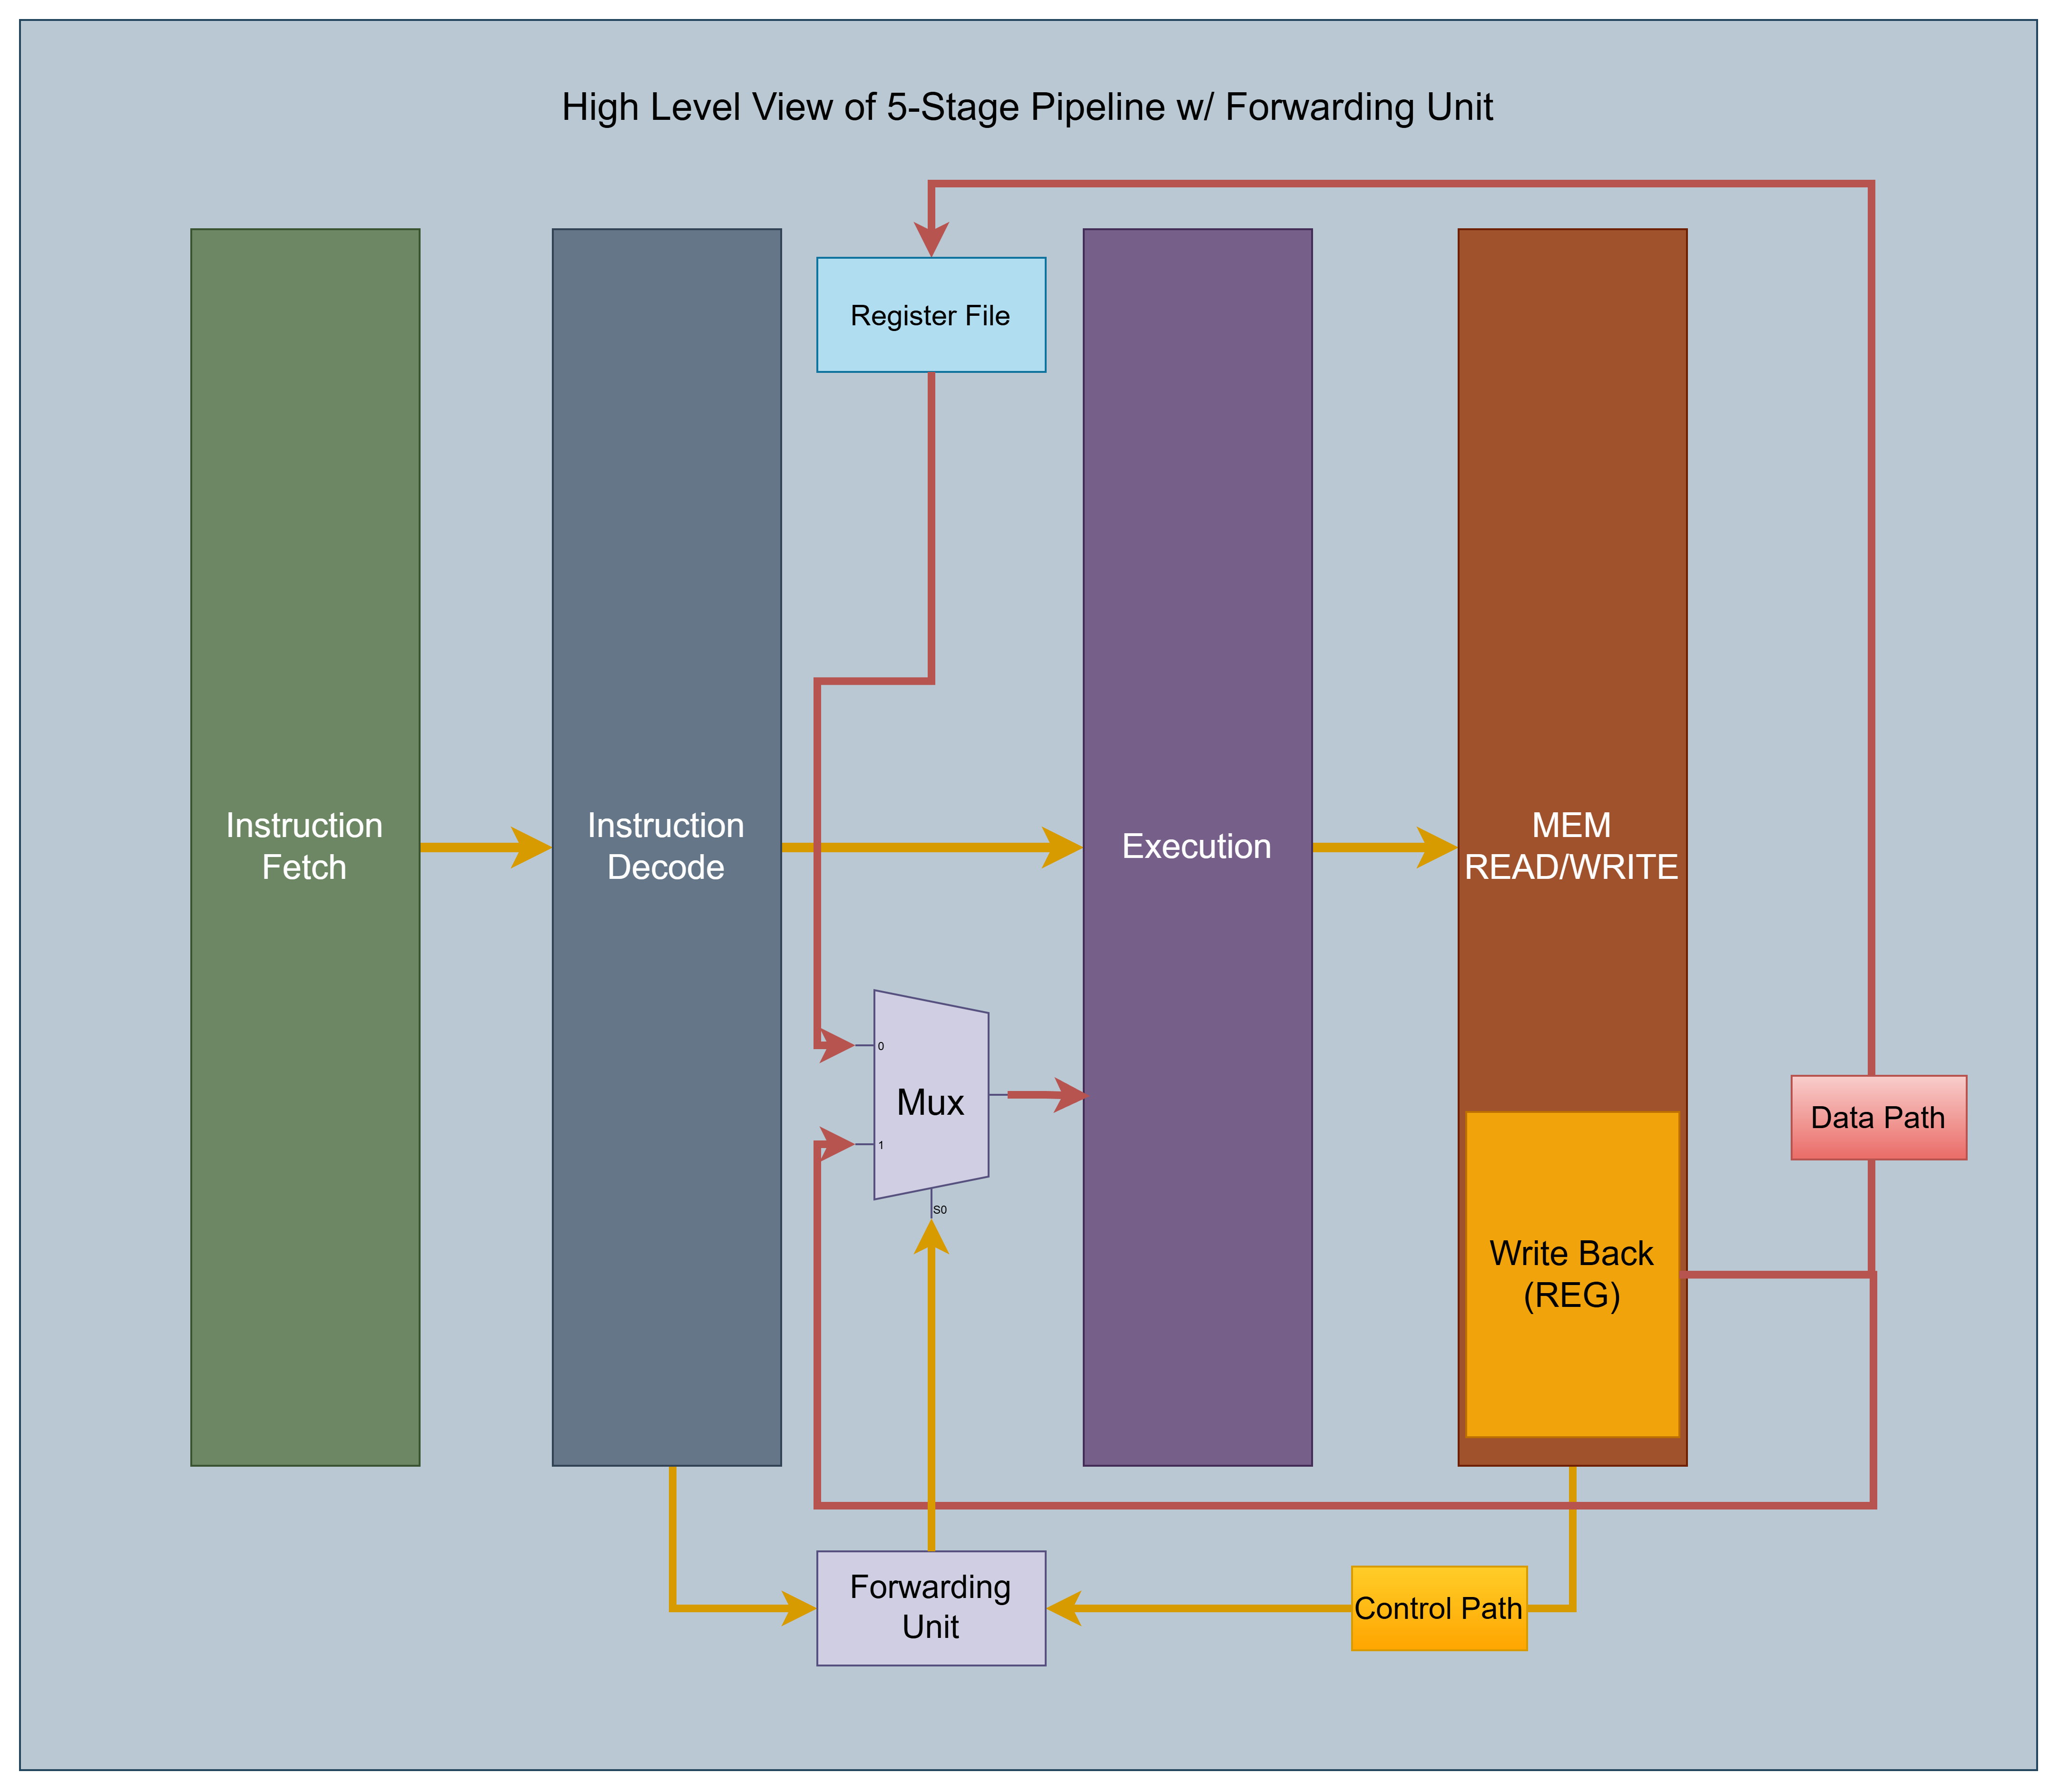
RAPID-X Core
Merged WB & Mem stage.
Optimized FSM to reduce overhead.
Optimize combinational logic for better setup timing.
Add registers to avoid combinational loops.
Update data path to fix race conditions.
Notes:
The RAPID-X iteration had better optimzied finite state machines and combinational logic. The FSM reduced the clock overhead and the improved combinational logic provided better slack and hold time which means we can run the core at a higher frequency. We also changed how the components were layed out to fix the race conditions.

Slide 20
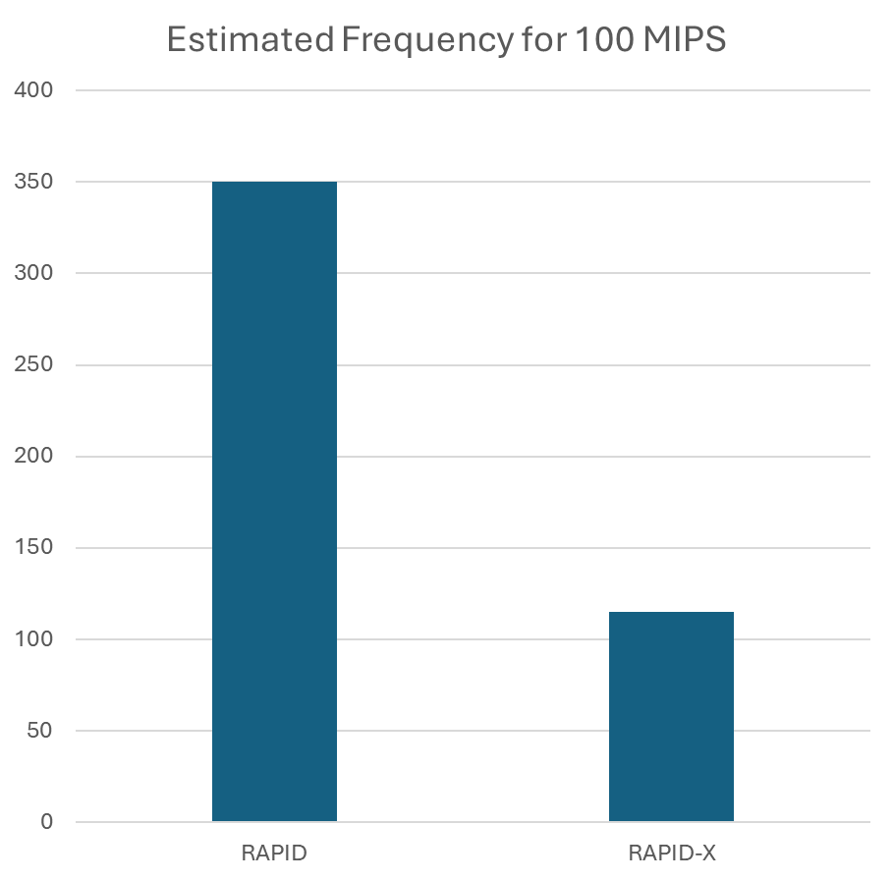
Quick Summary of Improvements
Reduced core clock speed requirement from ~350 MHz to ~115 MHz
Notes:
Here is a quick summary of the improvments, The picture on the left shows the pipeline latency improvements. Pipeline latency is the time it takes for an instruction to be fully processed in the pipeline. The picture on the right shows the improvement in the IPC rate.

Slide 21
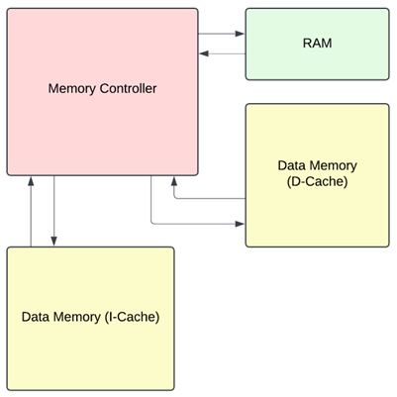
Memory Architecture and Design
Split data-cache and instruction-cache
8 MB single-level cache for each, for a total of 16 MB
Direct-mapped cache to simplify implementation; open to exploring associative caches if benchmarks show potentials for improvement
High-Level Block Diagram

Slide 22
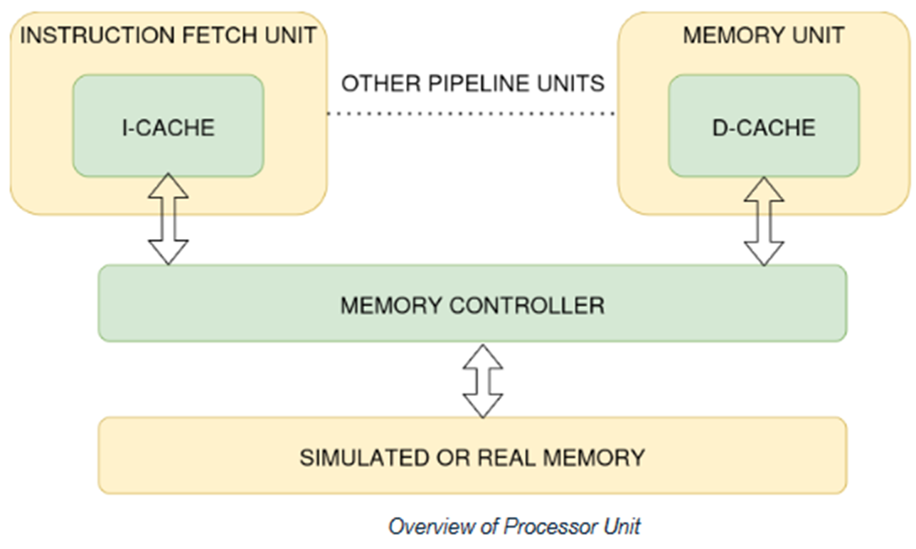
Cache Subsystem
Same cache module is instantiated twice for the I-Cache and D-Cache, providing better re-usability
Simulated memory is initialized at start of simulation with machine code

Slide 23
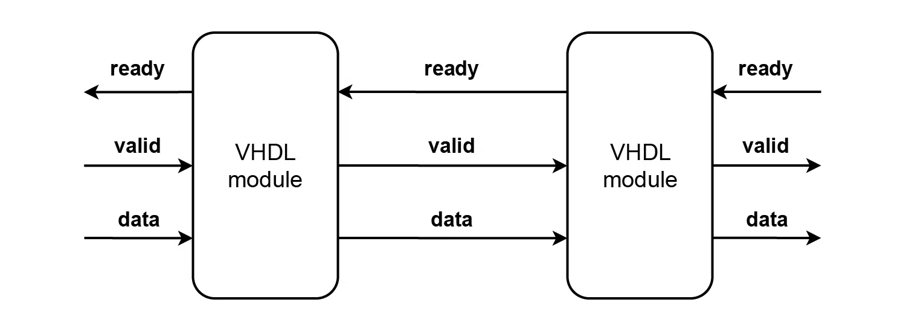
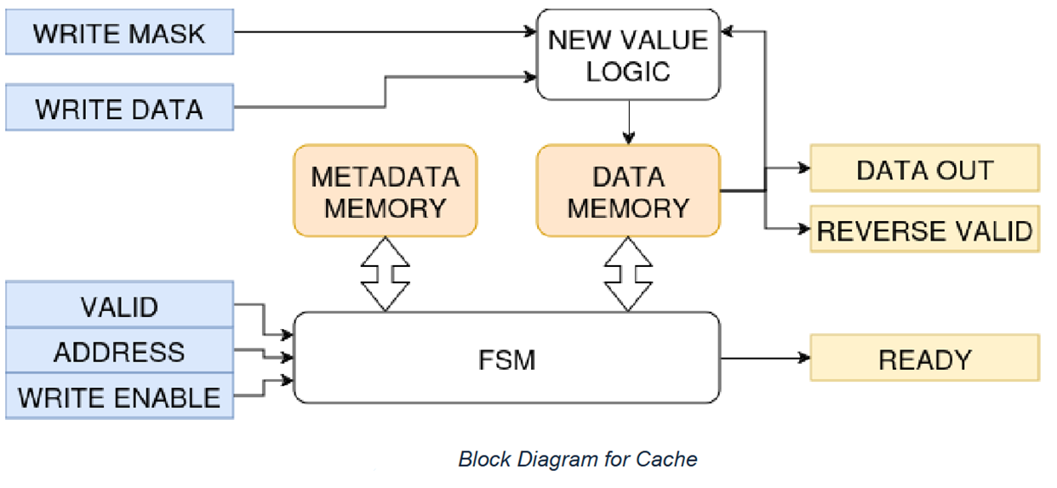
Cache Subsystem Protocol
The ready/valid protocol is a simple handshake framework commonly used in digital circuits.
In our use case, it provides robust synchronization and signaling between cache subsystem and CPU pipeline.

Slide 24
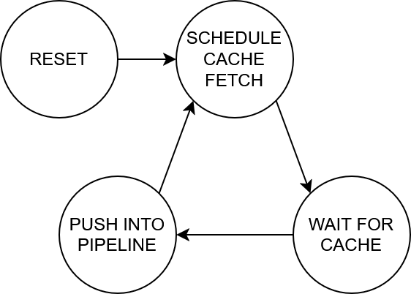
Instruction Fetch and Optimizing the Pipeline
Challenges:
Modeling the Inst. Fetch. as a Finite-State Machine
Result gives poor performance because:
Must traverse three states to push an instruction to the pipeline
Incapable of streaming instructions back-to-back
Severely cuts down IPC as the pipeline keeps waiting on fetching the next instruction
A new instruction fetch stage design was needed.

Slide 25
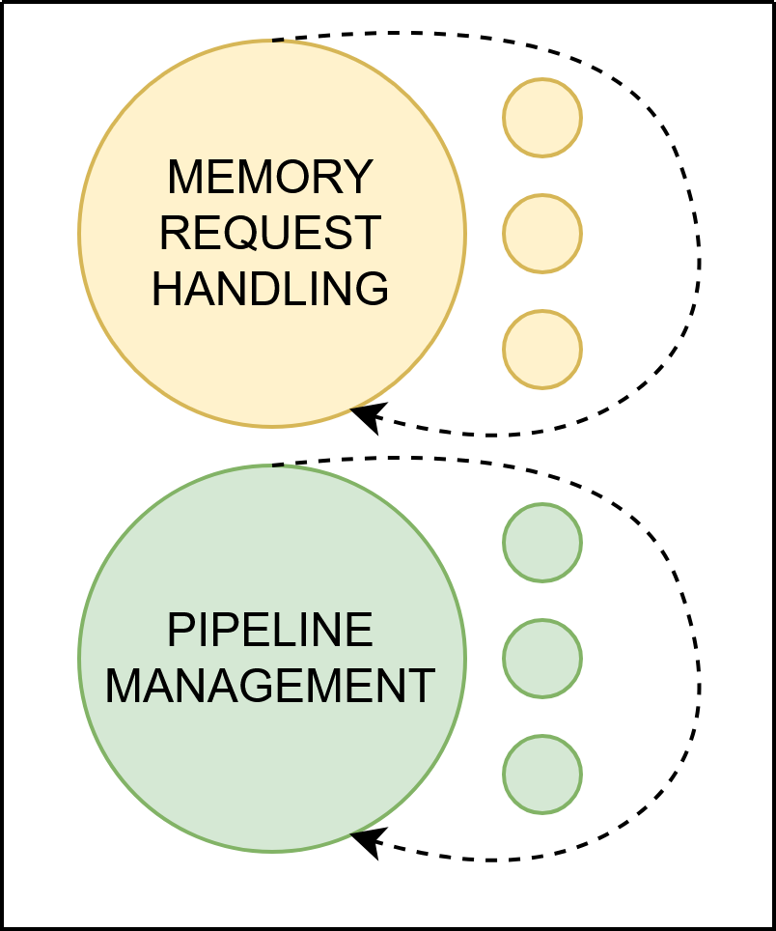
New Instruction Fetch
Takeaway:
It's very important to optimize the instruction fetch stage because it's first in the pipeline.
The new implementation performs:
Pipeline control and cache request handling in two concurrent blocks.
Doesn't use an FSM
Prefetches several instructions at a time
Results:
The instruction fetch stage is now capable of pushing a new instruction to the pipeline every clock cycle*. (*During an I-cache hit; excl. branching instructions)

Slide 26
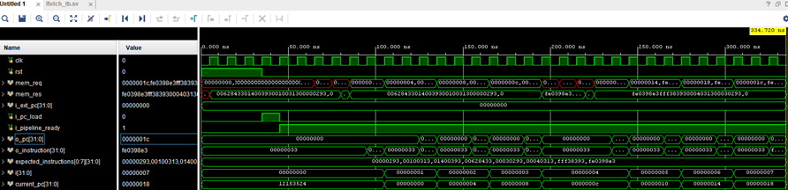
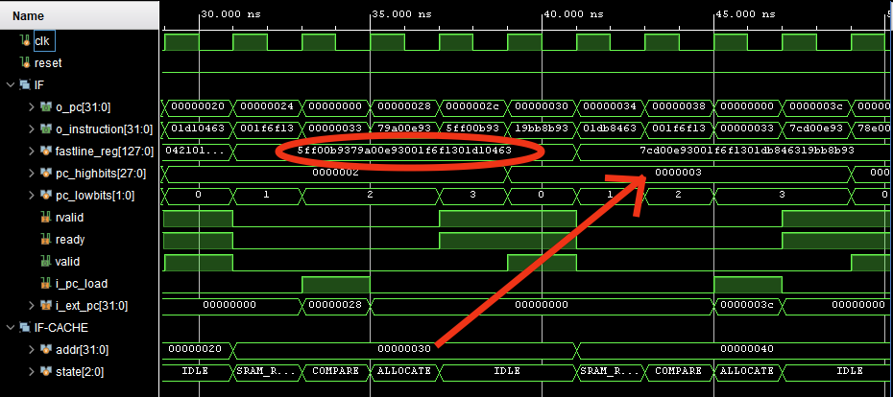
Old v. New IF - Comparison
Above: old design.
Note how two NOPs (0x33) are inserted into the pipeline between each real instruction.
Essentially cuts IPC by 1/3.
Left: new design
A new instruction is pushed every clock cycle; also shows prefetching a block of four instructions.

Slide 27
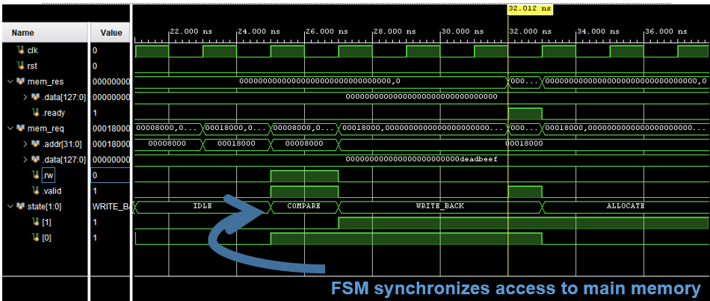
Cache signals in waveform viewer

Slide 28
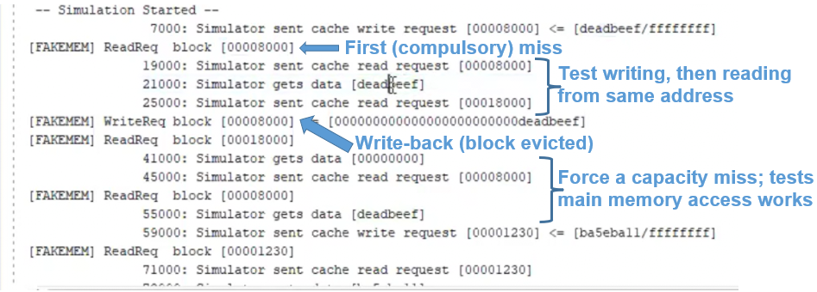
Cache and fake memory simulation log

Slide 29
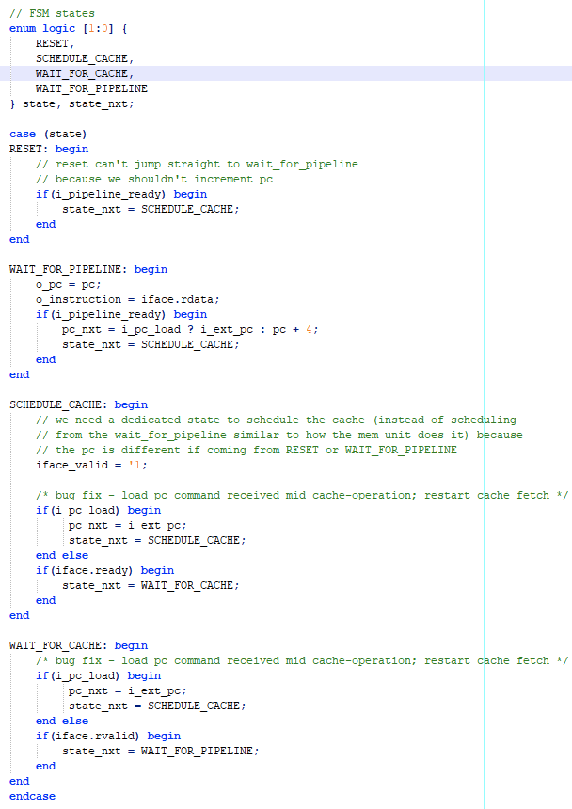
Instruction Fetch and Optimizing the Pipeline
Challenges:
Modeling the Inst. Fetch. as a Finite-State Machine
Result gives poor performance because:
Must traverse three states to push an instruction to the pipeline
Incapable of streaming instructions back-to-back
Severely cuts down IPC as the pipeline keeps waiting on fetching the next instruction
A new instruction fetch stage design was needed.

Slide 30
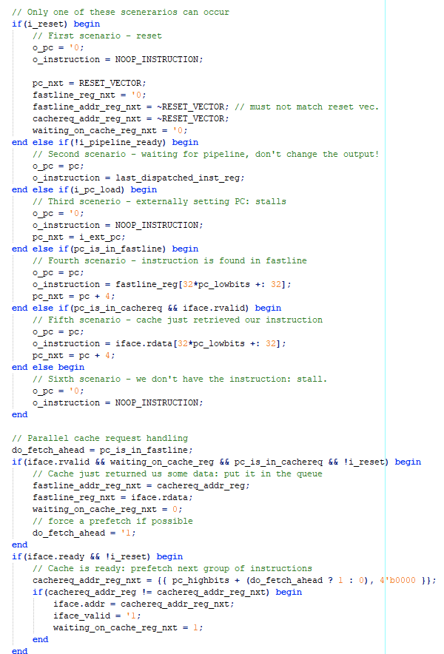
New Instruction Fetch
Takeaway:
It's very important to optimize the instruction fetch stage because it's first in the pipeline.
The new implementation performs:
Pipeline control and cache request handling in two concurrent blocks.
Doesn't use an FSM
Prefetches several instructions at a time
Results:
The instruction fetch stage is now capable of pushing a new instruction to the pipeline every clock cycle*. (*During an I-cache hit; not including branching inst.)

Slide 31
Instruction Fetch Testing
Preload sequence of instructions
Validate FSM transitions, PC updates, and cache communication
Simulate edge cases
Sequential fetching when the pipeline ready flag is 1
Produce a no op for memory stalls
Correct synchronization with pipeline and accurate instructions delivery

Slide 32
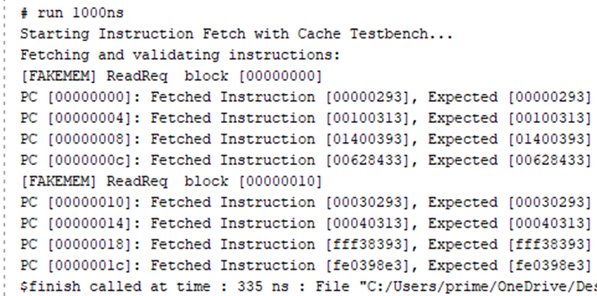
Testing Waveforms and logs
Notice matching fetches even after moving to another cache line.
Initial testing of the IFetch required testing its interaction with the Instruction cache.
Here we tested using a standard testbench and comparing captured data with expected results.
The testbench compares fetched instructions against known expected values detailing correctness at each PC.
This test does not include branching.

Slide 33
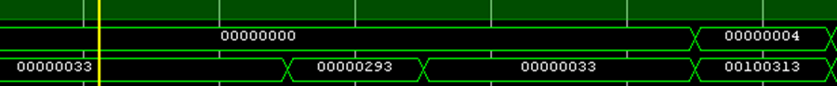
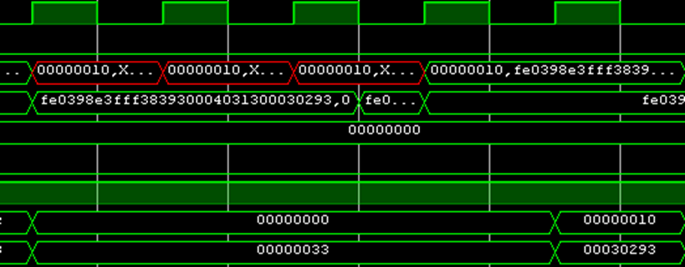
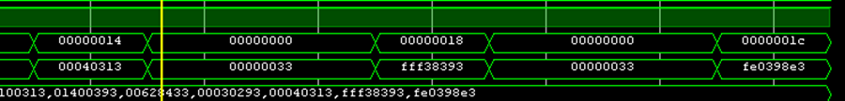
Testing Waveforms and logs
Here is the simulation waveform for the initial testbench.
Notice how the PC lines up with its respective instruction.
Indicates cache line shift.
Even after cache line shift, the PC continues to line up with its respective instruction.
Demonstrating proper functionality for the Instruction Fetch stage

Slide 34
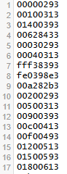
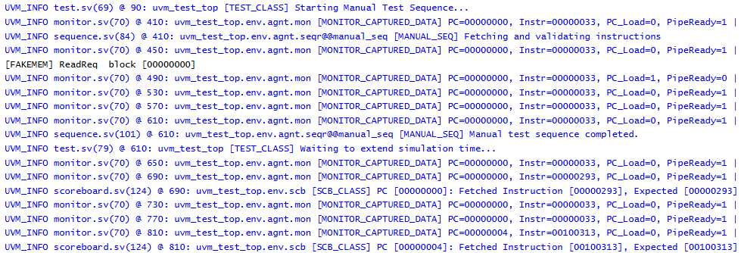
UVM Report of IFetch Testing
UVM implementation of the previous testbench.
Obtained a successful report and observed proper functionality.
Due to the nature of UVM, combining all file dependencies for this multi modular testing proved tedious but the report demonstrates successful functionality.
Notice the matching instruction fetched with the expected results.
Instructions from txt file being fetched.

Slide 35
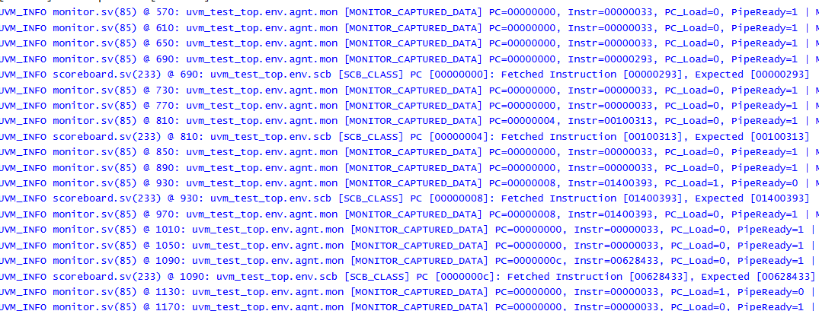
Additional Testing
Pointing to all successful instruction fetching from the UVM testing.

Slide 36
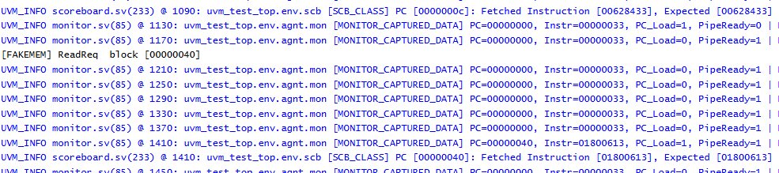
Additional Testing - UVM logs
External PC change testing

Slide 37
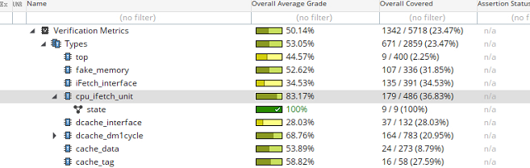
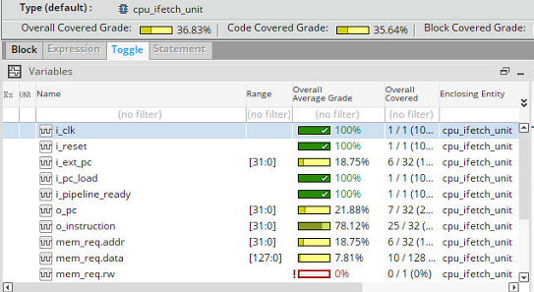
Code Coverage
Reached our target code coverage of close to 85%
Increased percentage can be obtained by further pushing external PC values
Limited memory request due to specific usage of the multi-purpose cache instance
Even with targeted testing we were able verify Instruction Fetch functionality

Slide 38

Static RAM Implementation Options
 | Advantages | Disadvantages
Inferred block RAM | Easy to code, directly in SystemVerilog Able to immediately change and test different sizes | Performance heavily dependent on synthesis tool Results in very high cell count
OpenRAM (Static RAM Generator) | Framework specifically optimized for ASIC design Tool automatically generates netlist, layout, and timing models | Moderately difficult to integrate into our design and verification workflow Takes several dozen hours to generate large memory blocks

Slide 39

SRAM Options
Feature | OpenRAM | Open-Mem | ASAP7
FreePDK45 Support | Yes | No | No
Open-source | Yes | Yes | Yes
Auto SRAM compilation | Yes | Partial | No
Generates GDSI | Yes | Partial | No
Cadence EDA support | Yes | No | Yes

Slide 40
OpenRAM
Open-source SRAM compiler
Automates memory design
Generates layouts, netlists, and simulations
Supports FreePDK45 technology
45nm open-source process design kit
PDK used for our core
Automates memory design and validation
Reduces manual SRAM design efforts

Slide 41
OpenRAM Output
GDSII Format
This is the standard layout format for fabrication used in the semiconductor industry
It can be imported into tools like Cadence Virtuoso for visualization, modification, or verification.
Verilog Model
A functional representation of the SRAM that can be integrated into digital design flows.
Enables behavioral simulation before full layout implementation.
Library Files
Used for logic synthesis and place-and-route (P&R) in ASIC/FPGA design flows.

Slide 42
OpenRAM Issues
Scalability Challenges
Struggles with very large SRAM sizes
OpenRAM has difficulty handling large memory instances efficiently.
Long generation times for high-capacity memories
As memory size increases, the layout and verification process becomes slower.
Limited Multi-Bank Support
Basic multi-bank memory generation
OpenRAM can generate multi-bank memories, but support for complex configurations is limited.

Slide 43
What are the different verification methods?
Method | Advantage | Disadvantage
Coverage Driven Verification (CDV) | Quantifiable testing goals and Automated test generation | Dependence on Quality Metrics False sense of security
Assertion Based Verification (ABV) | Early error Detection and Complementary to Simulation | Debugging complexity and Limited Scope
Constrained Random Verification (CRV) | Enhanced Discovery Bugs and Broad Test Coverage | Reliance on Seed Control
Universal Verification Methodology (UVM) | Modularity and Reusability and Built-in Support for Advanced Technique. Includes CDV, ABV and CRV. | Steep Learning Curve and Complex Debugging
Formal Verification – Stretch Goal | Exhaustive Analysis and Guarantee of Correctness | Computationally Intensive

Slide 44
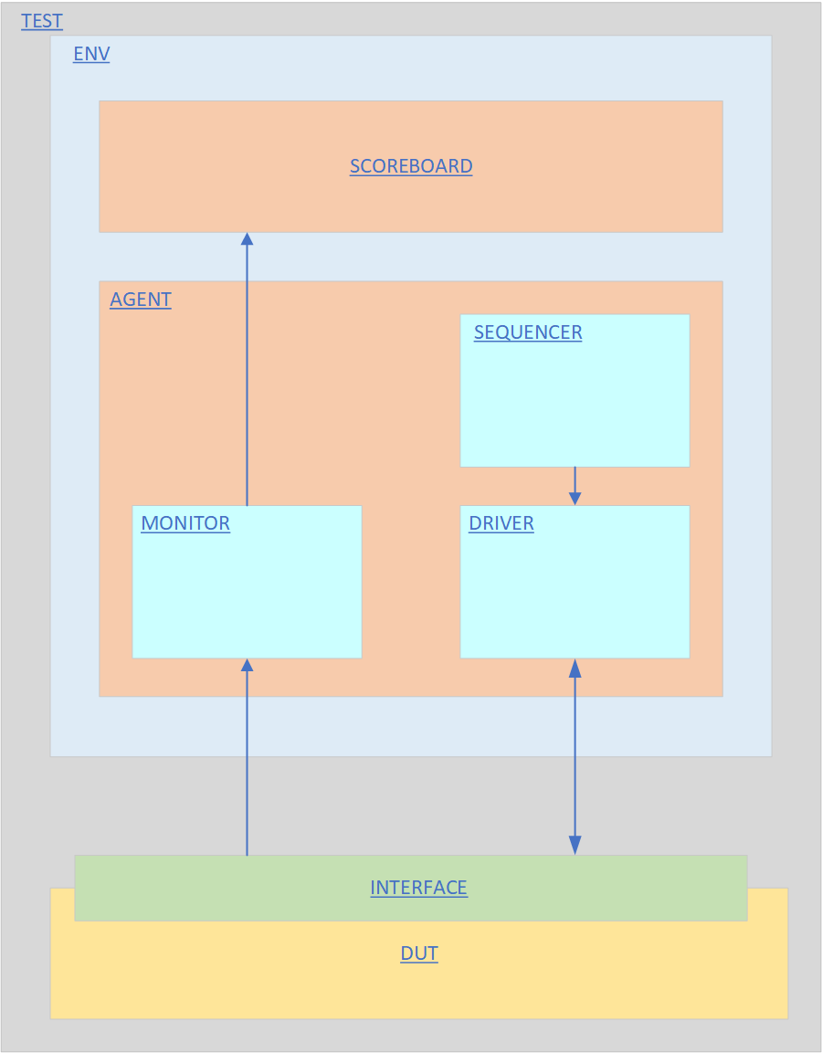
UVM DIAGRAM

Slide 45





Formal Verification
Red dots represent bugs in the system
Blue dots represent the system working successfully
The area enclosed by the two regions represents areas covered by other forms of verification, leaving behind some bugs that would be found by the use of Formal Verification.

Slide 46
Software Used for Verification
There are many software options for Verification such as Synopsis VCS, Cadence Xcelium, Questa and Jasper Gold. Combination of tools is always ideal!
Software | Usage
Synopsys VCS | Provided errors in great detail which was very beneficial for debugging.
Cadence Xcelium | Provided code coverage and provided the code which was not being covered. Very beneficial for debugging as well.
Jasper Gold | Still in training. This is a stretch goal for the project.

Slide 47
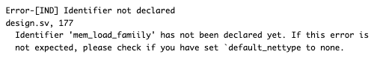
Verification Testing
Synopsys VCS error example

Slide 48
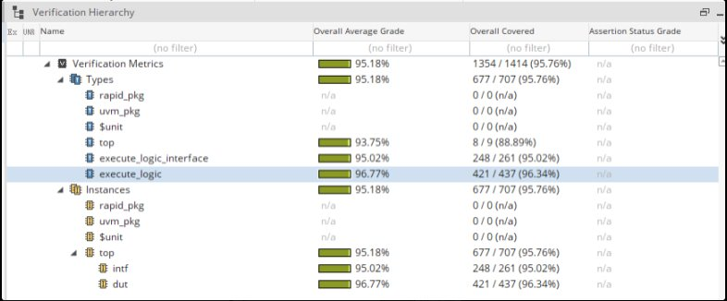
Xcelium Example

Slide 49
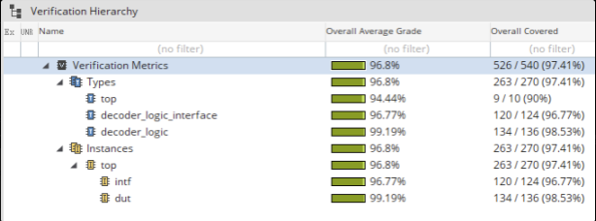
Decoder Logic

Slide 50
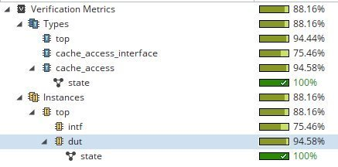
Memory FSM

Slide 51

Unit Test Verification
Purpose
Verifies individual RTL modules in isolation.
Focuses on specific functionality without full system complexity.
Helps catch early design bugs before UVM-level integration.
Why
Speeds up debugging — isolate problems early.
Improves coverage — ensures corner cases are tested.
Strengthens UVM Testbenches — unit-tested blocks lead to more reliable integration-level verification.
Notes:
In addition to the UVM testbenches, I wrote Unit Tests which focus on verifying small blocks individually before integration. These benches are lightweight and fast to run and make catching bugs easier in the early stages of development. They are also useful for verifying the UVM testbench results.

Slide 52
Example: Decoder Logic Module
Purpose: Verifies decoder_logic module independently.
How It Works:
Applies known RISC-V instructions (e.g., LUI, JAL, BEQ, etc.).
Checks each output field (load_upper_imm, uncod_branch, etc.)
Asserts correctness using a custom task.
Notes:
This is a example of the decoder logic testbench which systematically feeds known good RISC-V instructions into the decoder and verifies the output control signals as well as the immediate value are correct. It ensures our decoder logic is stable and reliable before integrating it into a bigger UVM environment as well as gives our team more confidence in the design.

Slide 53
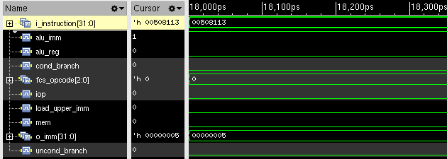
Decoder Logic: ADDI x2, x1, 5
ADDI x2, x1, 5 = 00508113
alu_imm = 1 as expected
Imm = 5 as expected
LUI = 0 as expected
Notes:
This is an example from the decoder logic testbench. It applies an ADDI instruction as the red box shows. You can see that the instruction was decoded properly into all of the correct control signals. This proves that for the ADDI instruction, the module properly decodes. This is one example but the testbench goes through all the supported instructions to ensure functional correctness to ensure all possible instructions are decoded properly.

Slide 54
Example: Forwarding Unit
Purpose: Verifies the behavior of the forwarding unit module
How It Works:
No forwarding required
Forward to rs1 only
Forward to rs2 only
Forward to both rs1 and rs2
Zero register behavior
Includes randomized stress testing to ensure robustness
Notes:
This example covers the forwarding unit module which verifies that the processor properly forwards data between pipeline stages when a hazard occurs. This test bench covers cases where no forwarding is needs, only one register needs to be forwarded, or when both need to be forwarded.

Slide 55
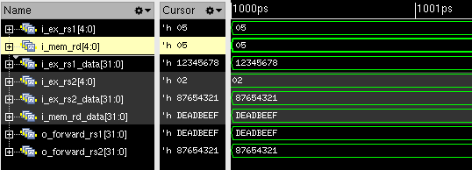
Forwarding Unit: rs1 forwarding
rs1 matches MEM destination
Original rs1 input
rs2 not forwarded
Original rs1 data is overridden
rs1 value correctly forwarded
Notes:
In the example the RS1 register matches the memory destination register. This means normally, RS1 would use the value 0x12345678 coming from the register file. However, since the most recent value is in the memory stage, the forwarding unit overrides the rs1 input. This means the execution stage will have access to the DEADBEEF value right away instead of waiting for it to be written back. This helps prevent a pipeline stall and continues smooth CPU execution.

Slide 56
Performance Measurement Methodology
Testbench Setup:
A special SystemVerilog testbench monitors the CPU.
Performance counters are collected during simulation:
Cycle Counter: Tracks total clock cycles.
Instruction Counter: Counts all retired instructions.
NOP Counter: Separately counts no-operation instructions
Notes:
Now, before running actual programs on the core to see how it performs, the next couple of slides describes the testbench that was written to measure the performance of programs running on the core. To collect performance measurements such as IPC, CPI, and MIPS its important to know how many instructions the program is executing and how many cycles it took to complete the program. Ideally the number of cycles should match the number of instructions, but due to memory stalls and data hazards this is not always possible. To get the numbers needed to calculate IPC and CPI we used a cycle and instruction counter. When the core is running it keeps track of what cycle we are on and also the current count of instructions it has run. These two metrics will be used at the end to calculate IPC and MIPS.

Slide 57
Performance Measurement Methodology
Program Start Detection:
Program officially "starts" when a real instruction (not NOP or NULL) is fetched.
Program End Detection:
Program "ends" when register t6 is set to 0xDEADBEEF
Notes:
To avoid inaccurate measurements the testbench will only start counting cycles and instructions when it's running the actual programs. This means it will not start counting until the CPU is fetching meaningful instructions. And the same thing applies to the end of the program. We don’t want to count the core doing nothing in our metrics so a special value is set to register t6, which lets the testbench know the program is done running and to stop collecting performance data.

Slide 58
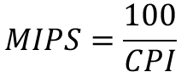
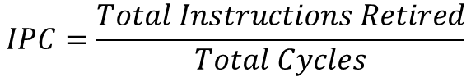
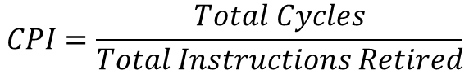
Performance Measurement Methodology
Cycles Per Instruction:
$$CPI=\frac{Total Cycles}{Total Instructions Retired}$$
$$IPC=\frac{Total Instructions Retired}{Total Cycles}$$
Instructions Per Cycle:
Million Instructions per Second:
$$MIPS=\frac{100}{CPI}$$
Notes:
Once the program is done executing, it uses the following formulas with the performance data just collected to compute our measurements. CPI, or cycles per instruction is simply the total number of cycles divided by the total number of retired instructions. A lower CPI is better, meaning the core is doing more work per clock cycle. IPC, or instructions per cycle, is the reverse of CPI. It divides the total retired instructions by the total number of cycles. Higher IPC indicates better CPU efficiency. And finally we have MIPS, or Million Instructions per second. Because our core runs at a 100MHz clock frequency, MIPS is calculated by dividing the frequency of 100 by the CPI. Together these metrics give us a full picture for the cores performance.

Slide 59
Running Programs on the CPU
Fibonacci
Matrix Multiplication
Greatest Common Denominator
Sum of Two Arrays
Reverse Array
Factorial
Sum of Natural Numbers
Bubble Sort
Selection Sort
Stack
Notes:
Now ill go over some actual programs running on the core. These will give us some performance metrics and allows us to see how our core responds to real code.

Slide 60
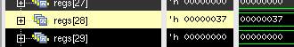
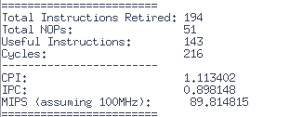
Fibonacci
Program: Calculates the first 10 Fibonacci numbers
Output: Stores the 10th Fibonacci number into the s3 (x28) register
Performance:
Tests:
Loops (branching, comparison)
Arithmetic (add, mov)
Register file (reads/write)
Metric | Measured
CPI | 1.13
IPC | 0.90
MIPS | 89.81
Notes:
The first program tested generates the first 10 Fibonacci numbers and stores the 10th number in the the s3 register. As you can see the program successfully executed and we got a value of 0x37 in hex which is 55 in decimal. You can also see the performance metrics measured when running this program on the core. After running it through the measurement testbench I recorded a value of 1.13 for CPI, which is reasonable given the mix of control signals and memory usage. IPC is 0.90 due to the nops and memory stalls introduced into the pipeline. Now that we have the IPC the testbench does a simple calculation to give us our 89.8 MIPS for this program. After I showcase all the programs I will go into more detail about the perofmace of the core and why we are not at 100 MIPS.

Slide 61

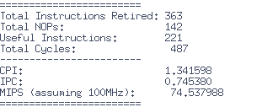
Factorial
Program: Calculates the factorial on n
Output: Stores the factorial of 5 into register s3 (x19)
Performance:
Tests:
Function calls (jal / jalr)
Recursive Functionality
Conditional Branching
Register File Usage
Metric | Measured
CPI | 1.34
IPC | 0.75
MIPS | 74.54
Notes:
This program tests our cores ability to run recursive functions. It makes use of the jump and link and stresses the stack by saving and restoring register state. It also tests conditional branching with the base case for the factorial function. You can see that the program was executed successfully by computing the factorial of 5, and storing it into the s3 register. You can also see the performance metrics for this program running on our core which was used to calculate the overall average performance of our core.

Slide 62
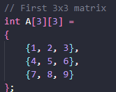
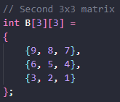
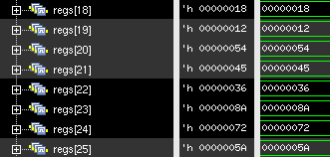
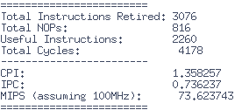
Matrix Multiplication
Program: Calculates a 3x3 matrix multiplication
Output: Stores the output matrix into registers s1-s9
Performance:
Tests:
Nested Loops (multiple branch and compare)
Array indexing and mem access (load/store)
Multiplication through repetitive addition
2D arrays
Metric | Measured
CPI | 1.36
IPC | 0.74
MIPS | 73.62
Notes:
This program tests a 3 by 3 matrix multiplication. The core multiples two matrices together by using three nested loops. This stress tests the control logic with lots of branching and comparison operations. It also tests array indexing which loads values from the input arrays and writes to the output array. This tests the cores load and store functionality. At the end the results matrix is transferred to the s1 through s9 registers for easy viewing. From the output you can see that the core successfully multiplied matrix A and matrix B together. Overall, this program has a good mix of control, memory, and arithmetic stress for the core.

Slide 63
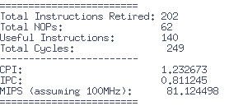
Sum of Natural Numbers
Program: Calculates the sum of N natural numbers
Output: Stores the sum into register s4 (x20)
Performance:
Tests:
Loops (branch and compare)
Sequential arithmetic
Register reads and writes
Metric | Measured
CPI | 1.23
IPC | 0.84
MIPS | 81.12
Notes:
This program calculates the sum of the first N natural numbers. The loop used for the addition ensures that the pipeline handles control flow properly. This program showcases the downsides of using a compiler to write the programs as opposed to pure assembly as all of the math is done in registers but still has a lower IPC due to the compiler inserting nops. Overall, this tests basic control flow, addition, and register operations.

Slide 64
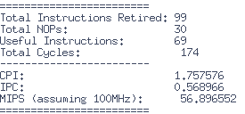
Greatest Common Denominator
Program: Finds the GCD of two numbers and stores them to a register
Output: Stores the GCD into register s4 (x20). GCD(40,10) = 10
Performance:
Tests:
While loops and conditional branching
Comparison operations
Arithmetic
Small loop bodies (causes stalls)
Metric | Measured
CPI | 1.76
IPC | 0.57
MIPS | 56.90
Notes:
This program calculates the greatest common denominator of two numbers using subtraction and comparison inside a while loop. In this example, it correctly computes the GCD of 40 and 10, resulting in 10 being stored in register s4. However, you can see that the MIPS are quite low. This drop in performance happens because the program heavily relies on branching inside a very small loop. Each iteration does very little actual work, which causes frequent pipeline stalls and data hazards. Overall, this test shows that while the core can correctly handle branch-heavy applications with tight loops, it does experience a performance hit when doing so.

Slide 65

Sum of an Array
Program: Computes the sum of a integer array
Output: Stores the sum into the s3 (x19) register. 1+2+3…+20=210
Performance:
Tests:
Simple for-loop control flow (increment, compare, branch)
Memory loads (array indexing + loading array values)
Arithmetic (addition of array elements into a running sum)
Sequential memory access (testing memory read throughput)
Metric | Measured
CPI | 1.60
IPC | 0.62
MIPS | 62.43
Notes:
This program computes the sum of a 20-element integer array. Each element is loaded from memory and added to a running total stored in the s3 register. The final value we expect is 210, and you can see that the result stored in s3 matches correctly. In terms of performance, this program is mainly sequential memory loads and adds inside a simple for-loop. Even though each iteration is doing real useful work — both a memory access and an addition — the relatively small size of the loop and frequent control flow still add overhead. We observe a CPI of around 1.60, and an IPC of about 0.62, leading to about 62 MIPS. This is typical for small tight loops, especially when the compiler inserts some NOPs for hazard avoidance. Overall, this test shows that our core is able to handle memory-bound workloads with decent performance, though it still highlights the cost of small control-heavy loops.

Slide 66


Reverse Array
Program: Reverses an array in memory. Input = {0,1,…,18,19}
Output: Reverses the array, and stores the first 2 and last 2 elements in the registers
Performance:
Tests:
Memory Loads and Stores (loading from and writing back to the array)
Control Flow (increment, compare, branch)
Swapping Registers
Sequential and random memory access
Metric | Measured
CPI | 1.41
IPC | 0.71
MIPS | 70.90
Notes:
This program reverses an array stored in memory. It reads elements from the beginning and end of the array, swaps them using a temporary register, and then writes the swapped values back. After the array is reversed, it stores the first two and last two elements into s-registers for easy viewing. Compared to the previous sum programs, this program has slightly better performance because each iteration does more useful work before the branch happens, which reduces pipeline stalls. Overall, this test shows that the core handles memory-heavy operations well, even when there's a data dependency between loads and stores.

Slide 67



Bubble Sort
Program: Uses the bubble sort algorithm to sort an array
Output: Stores the first two indexes and last to indexes in the registers of the sorted array
Performance:
Tests:
Nested loops (outer loop for passes, inner loop for comparisons)
Conditional branches
Pipeline stress from unpredictable branches
Metric | Measured
CPI | 1.44
IPC | 0.69
MIPS | 69.38
Notes:
This program implements a basic bubble sort algorithm to sort an array of integers in memory. The output is the first two elements and the last two elements of the sorted array, which are stored into registers for verification. Bubble sort stresses the pipeline because it uses nested loops, comparisons, and unpredictable branching, depending on whether a swap is needed. Performance-wise, the core achieved a CPI of around 1.44, an IPC of around 0.69, and about 69 MIPS, which is good for a branch-heavy and memory-heavy workload

Slide 68



Selection Sort
Program: Runs the selection sort algorithm on an integer array.
Output: Stores the first and last element of the sorted array into registers
Performance:
Tests:
Nested loops
Comparisons and conditional branches
Register to memory
Array indexing and memory access
Pipeline testing with predictable but frequent control changes
Metric | Measured
CPI | 1.34
IPC | 0.75
MIPS | 74.51
Notes:
This program sorts an array using the Selection Sort algorithm. After the sort completes, it stores the first and last elements into registers for verification. Selection Sort stresses the core by doing multiple comparisons, array indexing, and swaps. Unlike Bubble Sort, Selection Sort's inner loop only moves the minimum element once per iteration, which slightly reduces memory pressure and control hazards — which explains the slightly better performance. Overall, it shows the CPU can handle repetitive comparisons and controlled data movement efficiently.

Slide 69



Simple Stack
Program: Implements a simple stack with push and pop operations
Output: pops a value into register s3 and peeks the top and stores the value into s4
Performance:
Tests:
Stack operations (push, pop, peek)
Array manipulation and memory access
Branching (stack overflow/underflow checks)
Arithmetic operations (stack pointer increment/decrement)
Metric | Measured
CPI | 1.61
IPC | 0.62
MIPS | 62.14
Notes:
This program implements a very simple stack using an array. We push three numbers onto the stack — 10, 20, and 30 — then pop the top element and peek at the new top element afterward. You can see from the register window that we popped 30 into s3 and peeked 20 into s4, meaning the stack operations worked correctly. Most of the stalls come from checking conditions like if (top >= 0) every time we push, pop, or peek. Overall, this program shows the CPU’s ability to handle conditional branching even when they're tightly packed together.

Slide 70
IPC Evaluation
Notes:
After running all 10 test programs, we can step back and calculate the average performance for the core. This bar chart shows the Instructions per cycle for each benchmark tested, as well as the average IPC after running all 10 programs. From this chart we can see that the IPC varies depending on the program running, and what type of instructions are being executed. For example, the Fibonacci program had the highest IPC at 0.9, since it runs a simple loop with little branching. Another note to make is that the Fibonacci program ran all its operations on the registers, meaning there were very little reads from memory which is the biggest bottleneck for the core. On the other hand the GCD program performed the worst at around 0.57 IPC. This is mainly due to the heavy control flow and a lot of small loops in the program. In general, programs with more predictable control flow and more arithmetic operations performed better while memory heavy and branch heavy programs took a performance hit.

Slide 71
MIPS Evaluation
Notes:
This chart shows the Million Instructions Per Second, or MIPS, measured for each of the programs. Similar to IPC, we see that programs like Fibonacci achieve the highest MIPS, around 90 MIPS, because they execute a lot of simple instructions very quickly. Meanwhile, programs like GCD, which involve many branch decisions and small loops, perform worse — dropping down to about 57 MIPS. In general, programs that perform more arithmetic work without branching too often tend to have higher MIPS scores. MIPS is an important figure when evaluating overall throughput, but it should always be considered alongside IPC and CPI, because a high MIPS number alone doesn’t always mean better efficiency. The average MIPS across all programs came out to around 71.5 which is short of out 100 MIPS target. The next few slides will go over why we are not hitting 100 MIPS.

Slide 72

Clock Frequency and 100 MIPS Target
MIPS is directly tied to clock frequency.
At 100 MHz, reaching 100 MIPS would require perfect IPC = 1.0.
Real-world issues (branches, stalls, hazards) reduce IPC.
Even small delays significantly lower MIPS.
Example MIPS for Fibonacci program running at a higher frequency (200MHz):
$$MIPS=\frac{200}{1.13}≈177 MIPS$$
Notes:
Now, it's important to remember that the MIPS value is tied directly to the clock frequency. In our case, we’re running the CPU at 100 MHz. So to hit exactly 100 MIPS, we would need to retire exactly one useful instruction every single clock cycle — meaning a perfect IPC of 1.0. In real-world designs, that's extremely hard to achieve. There are branches, stalls, instruction dependencies, memory delays, and pipeline bubbles that all cause the processor to occasionally waste cycles. Even a few stalls or NOPs drastically lower the effective IPC, which then pulls down the MIPS score as well. For example, if we ran the same core at 200 MHz instead of 100 MHz — even without changing anything else — the MIPS would roughly double. So a program that achieved 71.5 MIPS at 100 MHz would achieve about 177 MIPS at 200 MHz, purely because of the higher clock rate, not because of better efficiency. So while 71.5 MIPS might be lower than our target, for our novel design it’s actually a respectable number.

Slide 73
Ideal Case: Near-Perfect MIPS with Pure Assembly
Program manually written in pure RISC-V assembly
Only register-to-register arithmetic instructions
No memory loads/stores, no branches, no hazards
No compiler-inserted NOPs
Pipeline runs at full efficiency nearly every cycle
Notes:
And to really push the limits of the core, I wrote a assembly program that performs only register-to-register arithmetic, without any memory accesses, branches, or dependencies between instructions. This creates an ideal pipeline condition where every stage is fully utilized almost every clock cycle.

Slide 74
Ideal Case: Fibonacci
00100513 # addi x10, x0, 1 ; x10 = 1
00100593 # addi x11, x0, 1 ; x11 = 1
00000613 # addi x12, x0, 0 ; x12 = 0
00000493 # addi x9, x0, 0 ; x9 = 0
05a00913 # addi x18, x0, 10 ; x18 = 90
00a00633 # add x12, x0, x10 ; x12 = x0 + x10
00058533 # add x10, x11, x0 ; x10 = x11 + x0
00c585b3 # add x11, x11, x12 ; x11 = x11 + x12
00148493 # addi x9, x9, 1 ; x9 = x9 + 1
fe9958e3 # bge x18, x9, loop ; if x18 >= x9, branch back
00058e33 # add x28, x11, x0 ; x28 = x11 + x0
00008067 # add x28, x11, x0 ; x28 = x11 + x0
Notes:
This is the hex dump from writing this program. Commented next to each hex code is its instruction. This program is quite simple. It computes the first 90 Fibonacci numbers and stores the 90t^{h} digit in the s2 register. While the 90th digit is to large to store in a 32-bit register the functnatlity of this program works and gives a good baseline for a longer more robust program. Unlike the other C-based Fibonacci program, this one is highly optimized, does not use memory, and does not have any nops inserted by the compiler as no compiler was used. This allows us to see a more ideal output of our core running.

Slide 75

Ideal Fibonacci Results
Notes:
As a result, the CPU achieved around 99 MIPS, extremely close to the theoretical maximum of 100 MIPS at 100 MHz. However, it's important to note that this kind of performance is not realistic for general-purpose programs — it's only achievable under highly idealized, restricted conditions. Also the output value is a overflow value due to the size of the 90th Fibonacci number. Real-world programs must deal with memory accesses, branching, and hazards, which naturally lower the effective throughput.

Slide 76

Initial Instruction Decoder UVM
Learning and Resources
Watched Cadence UVM training modules for foundational understanding.
Watched other UVM training resources online
Progress
Framework for the decode stage of the UVM testbench has been set up.
Basic testbench infrastructure is operational.
Current Gaps
Custom instruction generator is developed but not yet integrated into the testbench/DUT.
DUT is not producing the correct iop signals as expected.
Next Steps
Integrate the custom instruction generator with the UVM testbench.
Debug and fix the issue in the DUT logic affecting the iop signal generation.
Ensure all instructions are properly being decoded

Slide 77
Obstacles
UVM Learning Curve
Understanding UVM concepts such as sequences, agents, and virtual interfaces was a long process
Initially not knowing if my lack of UVM knowledge was the reason for failure or there was an issue with the design
Core / Signal Redesign
Adapting existing testbenches to the new design requires significant time
Adds lengthy debug process to find errors where existing testbench gives an error

Slide 79

Custom Instruction Generator
Custom SystemVerilog module to generate random valid instructions
Outputs a random valid 32-bit RISC-V instruction
Generates valid random data depending on the instruction type
Properly encodes(combines) the bits into a 32-bit instruction
Still working on integrating into existing UVM testbench

Slide 80

Full Core Verification
Testing of completed core using randomized instruction generation.
Comparison with emulator for validation.
Automation of result analysis.
Notes:
While the UVM team continued developing more comprehensive verification, Nicolas and I began full core-level verification. The goal of this process was to execute randomly generated programs on the core and compare the outputs against a reference model.
By feeding the same constrained-random instructions into both the core and the emulator, we could identify divergences in execution results. A custom log-checker tool allowed us to trace and pinpoint the exact instruction where the core’s behavior diverged from the emulator.
This methodology helped uncover numerous bugs that wouldn’t have been detected by verifying individual hardware blocks in isolation. One challenge we faced was with randomly generated branch instructions, which often led to infinite loops. Due to time constraints, we addressed this by creating a dedicated branch test rather than relying on random generation.

Slide 81


Full Core Verification
Emulator & Compiler written in C++
RV32 instruction generator in System-Verilog.
Analysis program written in C#
Notes:
This slide shows the emulator running. The assembly code on the right is the randomly generated program while the picture on the left is the custom emulator. The emulator would output a csv text file which contains the CPU state after the execution of every instruction. The random program generated was made in System Verilog while the emulator was written in C++.

Slide 82


Full Core Verification
The 'log-checker' analysis program compares the 260k instruction results from both the emulator and core. Verified with 3rd party tools (Ripes.me)
CPU state is parsed to formatted (.xls) or .csv file for further debugging.
Notes:
The last step in full core verification was the analysis step. Here, we compare the outputs from both core and the emulator. The picture on the right shows the output of the log-checker program. The excel window shows an example where the emulator and core had computed different results. We would determine which instruction failed and then start a debug session analyzing why and where the core failed. We would repeat this process until we could not find any more bugs.

Slide 83
Logic Equivalency Checking using Conformal LEC
Stretch Goal
Used write_do_lec command in Genus to generate .do file for Conformal
Command: lec –XL –nogui –color –64 –dofile <.do file here>
RTL vs. Netlist Equivalence
Type of formal verification
Ensures functional correctness was maintained after synthesis with respect to RTL

Slide 84

Logic Equivalency Results
Successfully obtained a passing logic equivalency report.
Initially had to debug non -equivalent faults through diagnoses and netlist review
In the compare results sections, we see all equivalent compare points and zero non-eq points.
Pass

Slide 85

ASIC Flow
The ASIC Back-End is very dependent on the front end. The physical layout is heavily dependent on design in the RTL stage, because efficient RTL allows for efficient layout and thus a higher frequency when implemented.
The goals for the physical design are a design which can reach 100MHz under the operating conditions of 0.95-1.25V and 0-125C.

Slide 86
Metrics
From this point on the project will mainly be defined by slack and DRVs/DRCs, so it is good to define what they are here.
Slack represents the available time margin within a clock period before our signal causes a timing failure. Positive slack means that we are ahead of the required time and negative slack means we are causing a violation.
We will see slack for setup and hold times. Setup time is the minimum amount of time a signal has to reach an input before the clock edge and hold time is the minimum amount of time after a clock edge where the input must be stable.
DRVs and DRCs are design rule violations and design rule checks. Design rule violations are often due to conditions not defined in a PDKs library and can be as simple as driving a capacitance higher than tested. Design rule checks are tests to see manufacturing violations such as minimum spacing between cells or shorts between wires.

Slide 87
Process
Feature | SkyWater130 | FreePDK45 | TSMC 7nm
Technology Node | 130 nm | 45 nm | 7 nm
Process Type | Bulk CMOS | Bulk CMOS | FinFET
Availability | Open-source | Open-source | Proprietary
Typical Supply Voltage | 1.2–1.8 V | 1.1 V | 0.7–0.8 V
Performance & Power | Moderate performance; balanced for cost-sensitive, prototyping designs | Moderate performance; higher power consumption compared to advanced nodes | High performance with low power consumption
Density & Scaling | Lower density | Moderate density | Very high density
Some processes are better than others, but we chose FreePDK45 for a few important reasons.
The main reasons are as follows:
Technology nodes of 45nm can reach higher frequencies.
The PDK is open source.
The bulk CMOS is easier to work with than FinFET or other smaller nodes.

Slide 88
Synthesis Toolchain
 | Cadence Genus | Synopsys Design Compiler | Xilinx Vivado
Performance | High (Analog) | High (Digital) | Med
HDL Support | High | High | High
Cost | High | High | Low
Toolchain | High | High | Low
Due to the comparable features to Synopsys Design Compiler as well as the compatibility with Cadence Innovus, choosing to use Cadence Genus for synthesis was a simple decision.

Slide 89

Synthesized Netlist
Here is a view of our synthesized netlist. The gates shown within the view are one step closer to a physical implementation of the logic written in RTL.
This netlist was generated with relatively high optimization and contains about 9000 leaf cells, which can be broken further down into individual transistors.

Slide 90



Synthesis Optimizations
Here we can see the difference between a netlist generated with only liberty files (top image) and a netlist which uses physical files such as lef files and multiple RC-corners (bottom image). The top image estimates an RC corner of 1.25V and 0C while the bottom image shows a corner at 0.95V and 125C.
Synthesis which takes into consideration physical effects such as input voltage and temperature. The effects of poor conditions can be seen by the lack of margin in slack shown in the histogram below.
Number of Paths
Slack in ns

Slide 91

Floor & Power Planning
Floor planning is important for a chip because it allows for better yield. A poorly planned chip can be much worse than a well planned chip, and in some cases not work at all depending on IR drop.
To the right are two possible floorplans for a proposed chip, aesthetically you can guess which floorplan is better. The physical specifications of the chip is often not up to the physical designer (shocking), so engineers must be flexible in how they floorplan.

Slide 92


Initial Physical Layout using Innovus – Pre-pins and Cache
An example of layer routing
Initial layout pre-cache

Slide 93

Floor & Power Planning
Here you can see that we spread our pins based on the distance to the cache, and we have a relatively fine power grid on layers 7 and 8.
Power pins can also be seen distributed around the chip.
This is a block level design, so there are no IO pad spacing requirements other than meeting the specific pin spacing allowed by the PDK.
Our die size ended up being:
1150 x 700 um

Slide 94

Floor & Power Planning
For this chip we arranged the signals as follows, due to the resistance becoming higher in lower layers.
In general, we had power on the highest and lowest levels with logic in between.
Layer | Signals
10 – 9 | Core Power Rings
8 – 7 | Power Grid Stripes
6 – 5 | Clock, Reset, and other Global Signals
3 – 4 | IO Signals such as memory in and out, some Clock and Reset signals
1 – 3 | Local signals between Standard Cells as well as VDD/VSS tracks
Snapshot of Layer 8 down to Layer 1

Slide 95
Cache Review
Parameter | Min | Typ | Max | Units
Power supply (VDD) range | 0.95 | 1.1 | 1.25 | Volts
Operating Temperature | 0 | 25 | 125 | Celsius
Operating Frequency (F) |  |  | 646 | MHz
Our cache is generated using the OpenRAM memory compiler.
Our cache is much faster than the rest of our CPU, and we saw 4ns of slack required to be allocated to each cache in our worst corner. A maximum operating frequency of 650MHz certainly meets that requirement.
One issue is that the macro for the cache was very difficult to work with and involved some edits. This has been documented in other works in the past.
Pins | Mode | Power | Units
!csb0 & clk0 & !web0 | Read Rising | 6.5904 | mW

Slide 96

Total Power
Considering that both our cache are identical, and that the OpenRAM cache uses about 7mW of power each and the core uses 3.35mW, the chip in total uses under 20mW of power. This is certainly well within the specification of 1 W.

Slide 97


Rail Analysis
For our rail analysis we can see that we have less than 40mV of IR drop, which is less than 5% of 1.1V and meets specification.

Slide 98

Clock Tree Synthesis
Clock tree synthesis aims to minimize the clock skew across our chip. The network for our core is relatively simple, but in larger designs this stage is crucial.

Slide 99

Timing Report
Here we can see that our post signoff report shows that our setup and hold slack is positive. Signoff simulations are the most accurate representation of how the processor will perform in the real world.
As long as we have setup slack, we can always increase our hold slack, so the fact that the hold mode is only optimized to 0 slack is normal.
The max_cap DRV can be ignored due to the violation being so small. All this design rule violation means is that there is a capacitance on a net outside the range defined in the .lib file, but due to this violation being so low we can ignore it. There were significant max_cap violations earlier in the design which were fixed with stronger buffer cells.

Slide 100

Typical Timing
We estimate that with typical timing we could reach 100MIPS with our typical corner.

Slide 101


Timing Map & Chart – Show Timing Distribution
# of Path
Hold slack in ns
Slack distribution for 125C, 0.95V ranging from blue (high slack) to white (low slack) for setup time among the main logic cluster.
9.06 -> 0.23 ns of slack
Hold time slack distribution for our typical corner at 25C 1.1V

Slide 102

DRC
This report shows that there are no DRC violations, so the core is ready to be exported as a GDSII file.

Slide 103

GDSII
This final GDSII contains the layer information needed by the foundry.
It is being shown in KLayout.

Slide 104

Modus & Genus: DFT & ATPG
Design for Test are a set of design techniques and features for efficient manufacturing testing
Involves special test structures such as scan chains or built-in self-test circuitry to the chip
Relevant because it's good to detect defects from fabrication
Simplifies test development
Facilitates debugging
Block Diagram of a Scan Chain

Slide 105

Synthesis with Design for Testability (DFT) Insertion
Could not implement muxed Scan Chains using FreePDK45
Reason being FreePDK45 does not have the test cell definitions to support this; old .lib cell library
Used Synopsys 32nm Process Design Kit (PDK) to complete DFT flow

Slide 106



DFT Insertion Results Using Synopsys32nm
In the scan chain report we can see the 8 scan chains and the registers that have been partitioned respectively
Here we can see in the synthesis log that 8 scan chains have been configured

Slide 107
Testing the core using Automatic Test Pattern Generation using Modus
ATPG leverages the inserted scan chains
Meant to identify manufacturing defects in ASICs post fabrication
DFTs improve fault detections and makes test coverage more comprehensive
DFTs insert test structures and ATPG uses them to generate tests
Used the write_dft_atpg command in Genus to generate script

Slide 108
ATPG Script Breakdown
Build the logic model – creates the internal logic model used for ATPG
Build the test model – establishes the test mode setup in our case being 'FULLSCAN' for scan-based testing
Verify the test model – Checks whether the test model is consistent and valid
Build the fault model – Generates the fault model used by the ATPG tool
ATPG Test Generation – Generates actual ATPG patterns for testing under 'FULLSCAN'
Write Verilog vectors – Exports test patterns in verilog for simulation

Slide 109

ATPG Report Results using Synopsys32nm
Obtained a high fault coverage of 97.23% for static faults and 97.33% for collapsed faults
Relatively low untested value of 1883
Limited Dynamic Analysis

Slide 110


Modus: DFT & ATPG, Using FREEPDK15

Slide 111

RAPID-X System on Chip (SoC)
Inspired by peer review.
This prototype was build on the Atrix-7 FPGA board.
Combines the RAPID-X core with I/O peripherals to communicate with the outside world.
Demonstrates a functional core design.
Differences:
For the SoC, RAM is faster than the core therefore no cache system was included.
We used memory mapped I/O to communicate with the outside world.
Notes:
The RAPID-X System on Chip or SoC was a stretch goal we made in the last few weeks of the project. Basically, the SoC combines the core design with I/O peripherals to make a complete processor design. We had decided to add support for a display output, Serial UART, and USB keyboard.
There were some differences in the RAPID-X core used for the SoC. First we had decided to remove the cache system since the FPGA block RAM runs faster than the core so there was no latency when reading or writing to any address in RAM.
The second difference was the integration of the MMU or memory management unit which was used to map the I/O peripherals to memory addresses.

Slide 112


Gate Level Simulation
Gate level simulation can be performed after synthesis/routing and uses Xcelium with an added SDF file for GLS. This will be performed after proper routing optimization and the incorporation of the full SRAM & Cache.

Slide 113
Accomplishments

Slide 114
Notable Challenges and Solutions

Slide 115
Team Dynamics
Design Team – Youssef & Nicolas
System Design
Established modular requirements
Worked on redesigns
Initial Synthesis & Physical Layout
Full core verification
Memory Team – Pablo & Timothy
Worked on establishing the cache subsystem
Established functionality of IF & MEM stages
Testing of memory stage & IFetch
OpenRAM configuration
Verification Team – Davi & Evan
Verified essential units; Execution, Decoder, Memory FSM
Developed UVM reports for the Execute, Decoder, and Memory FSM
OpenRAM configuration

Slide 116
THANK YOU FOR THE SUPPORT!!!

